Slide 1
FHA FHIM Offsite
Galen input needed
June 13-14, 2017 Team Discussion
Apprio Inc., 425 3rd St SW, Suite 600, Washington, DC 20024
Phone: (202) 863-8410
June 15-16 FHA Report Out
FHA, 200 Independence Avenue Southwest Washington DC 20201

Slide 2
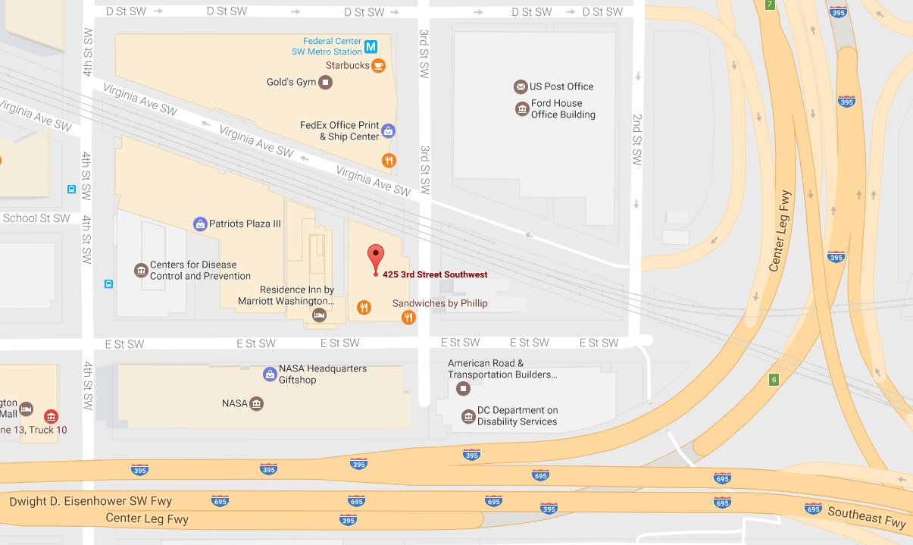

Slide 3
Agenda-at-a-Glance
TIME | DESCRIPTION
Tue 08:30 AM | FHA FHIM Overview Discussion (see backup slides)
Tue 09:00 AM | Galen: CIMI/FHIM Harmonization
Tue 10:45 PM | Jay & Rob: SOLOR/FHIM Harmonization
Tue 01:30 PM | SteveH: HL7 IIM&T Initiative
Tue 03:00 PM | Jay & Rob: VSAC Repository Support for FHIM Terminology Modeling
Tue 04:30 AM | Summary, Action Items and Update Day 2 Agenda
Wed 08:30 AM | Open Discussion
Wed 08:30 AM | Sean: Support for FHIR Implementations
Wed 10:30 AM | Sean: Tooling
Wed 01:00 PM | SteveW Pilot Testing
Wed 02:30 PM | FHIM Transition Planning
Wed 04:30 PM | Upcoming Events, Wrap-up, Action Items
Jun 13-14 FHIM Discussion Topics

Slide 4
Galen: CIMI/FHIM Harmonization
Current Status, Issues and Activities
Relationship to Other FHIM/FHA/Non-Government Initiatives
FHIM Team Participants and Non-FHIM Team Key Participants
FHIM Team Participants:
Non-FHIM Team Key Participants:
Long-Term Goal and Strategy for Achieving Goal
Description:
Estimated Timeframe:
Resources Required:
Other
Add additional slides as needed
Jun 13-14 FHIM Discussion Topics

Slide 5
Galen: CIMI/FHIM Harmonization
Status / Accomplishments / Uses / Value
Participants, Relationship to Other Initiatives
Note: You can adjust quadrant height and width
Strategic Goal, Plans/Timeframe, Resources Required
Issues, Risks, and Mitigation
Jun 15-16 FHA Report-Out
Notes:
Develop a high yield/ high value and common federal-wide health IT architecture
Promote a defacto national standard by leveraging federal purchasing power
Data exchanged is not based on the same standards
Need to include specific directions for the federal agencies for the ONC’s Interoperability Roadmap
Need to be mutually supportive of each other in HL7 votes
Validate and prioritize the architecture needs identified by FHA and the agencies.
Clarify the level of detail and scope of architecture
Provide the next level of detail that is targeted at a specific need or goal.
Address issues that are common concerns with multiple agencies.
Prepare Transition Plans in support of the next Administration.
Work with agency SMEs to provide an accurate picture of accomplishment in support of the ONC Interoperability Roadmap
Respond to congressional inquiries of the partners
Educate the GAO on achievements in federal health IT
Determine the level of support for CONNECT

Slide 6
Jay & Rob: SOLOR/FHIM Harmonization
Current Status, Issues and Activities
In process of requirements definition
FHIM relationship to CIMI; CIMI relationship to SOLOR; value proposition for US realm interoperability
Relationship to Other FHIM/FHA/Non-Government Initiatives
VA dependencies SOLOR
HSPC efforts for FHIR profile standardization in US realm
FHIM Team Participants and Non-FHIM Team Key Participants
FHIM Team Participants: Jay Lyle, Rob McClure, Susan Matney, Galen Mulrooney
Non-FHIM Team Key Participants: VA, FDA, CDC, NCPDP, DICOM, DoD, 3M, Intermountain Healthcare
Long-Term Goal and Strategy for Achieving Goal
Goal: Provide terminology bindings that support both extant interoperability requirements and the semantic harmonization of those requirements to support greater interoperability, including CIMI semantic framework assignments.
Strategy
Complete requirements definition
Implement proof-of-concept SOLOR bindings for CIMI (Skin & wound inspection)
Implement SOLOR bindings in appropriate technology & domain
Advocate for specification alignment using FHIM common repository
Assess SOLOR option for FHIM terminology support (contra VSAC)
Estimated Timeframe:
Initial proof of concept: 6 months
Full support: 18-36 months
Resources Required: Terminology & modeling support to continue FHIM/CIMI modeling & terminology coordination
Jun 13-14 FHIM Discussion Topics
Notes:
FHIM relationship is to CIMI, and CIMI to SOLOR

Slide 7
Need for additional clarity re: SOLOR
How does the SOLOR value proposition support FHIM?
Status: How much design is completed and how much can still change?
Scope & schedule for content (skin & wound draft release 10/31)
Access - how content will be served, and to whom
CIMI use of SOLOR: logical, physical
Option for FHIM direct use of SOLOR
Content boundaries: Inclusion of specialized code systems (SOP, HL7, CPT, etc.)
Model boundaries: Degrees of freedom from SNOMED CT concept model – SOLOR changes, OWL, other semantics
Alignment with LEGO and significance for FHIM

Slide 8
Jay & Rob: SOLOR/FHIM Harmonization
Status / Accomplishments / Uses / Value
SOLOR is under development within the test case of Skin/Wound Assessment.
Initial test SOLOR content target availability October 2017
Use case is built around a single logical model that supports inferencing using Description Logics
Participants, Relationship to Other Initiatives
VA building SOLOR on HSPC namespace
CIMI using SOLOR
FHIR interested in SOLOR, planning on mapping to SNOMED CT & investigating incorporating CIMI
HL7 relationships to be determined
Strategic Goal, Plans/Timeframe, Resources Required
Short-term goals stated
Long-term goals under development
SCT-based expressions central to SOLOR, CIMI; FHIM role supportive
Issues, Risks, and Mitigation
Value of use case driving unified terminology content and model aligned with information content to be proven
If FHIM can use SOLOR as “just another terminology source” while supporting legacy requirements, risk is minimized..
If SCT-based expressions are central to use of SOLOR, then this complex content will drive resource needs and interoperability issues for FHIM.
Jun 15-16 FHA Report-Out

Slide 9
Jay & Rob: VSAC Repository Support for FHIM Terminology Modeling
Current Status, Issues and Activities
VSAC in use for defining and hosting value sets bound in FHIM model
VSAC Collaboration in limited use for FHIM collaborative authoring of value sets
In process: VSAC services to support FHIM automated publication & validation
Relationship to Other FHIM/FHA/Non-Government Initiatives
NLM VSAC team
FHIM Team Participants and Non-FHIM Team Key Participants
FHIM Team Participants:
Jay Lyle, Rob McClure, Susan Matney, Galen Mulrooney
Non-FHIM Team Key Participants:
VA, FDA, CDC, NCPDP, DICOM, DoD, 3M, Intermountain Healthcare
Jun 13-14 FHIM Discussion Topics

Slide 10
Jay & Rob: VSAC Repository Support for FHIM Terminology Modeling
Long-Term Goal and Strategy for Achieving Goal
Goal
Provide up-to-date and versioned human and service-accessible value set definitions and expansions for all FHIM coded elements.
Provide authoritative value set definitions for common elements that can be leveraged by other stakeholders in US Realm (FHIR, C-CDA, etc.)
Strategy:
Continue FHIM terminology analysis & authoring, with Collaboration assistance
Continue FHIM terminology publication in VSAC
Identify stakeholders and resources for maintenance.
Estimated Timeframe:
Each domain takes 1-3 months of terminology development
Resources Required:
Development time to tie VSAC into publication and review process
VSAC development priorities are driven by federal stakeholders, resources
Jun 13-14 FHIM Discussion Topics

Slide 11
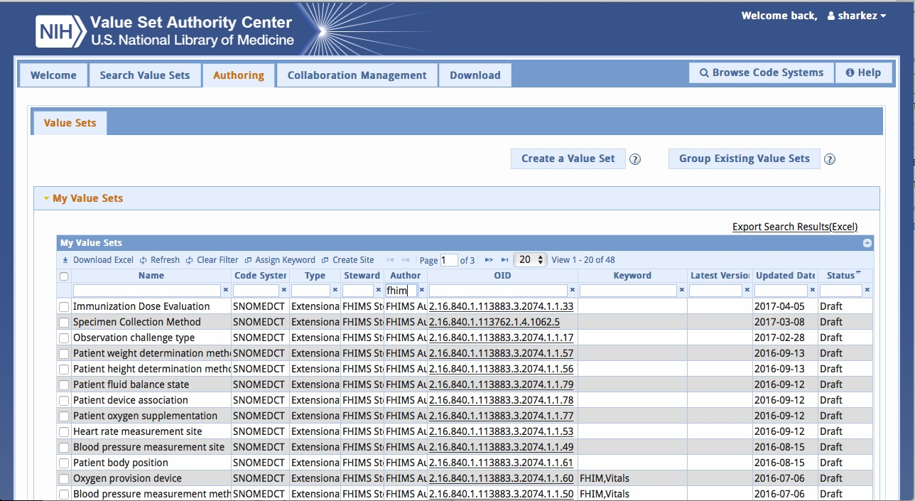
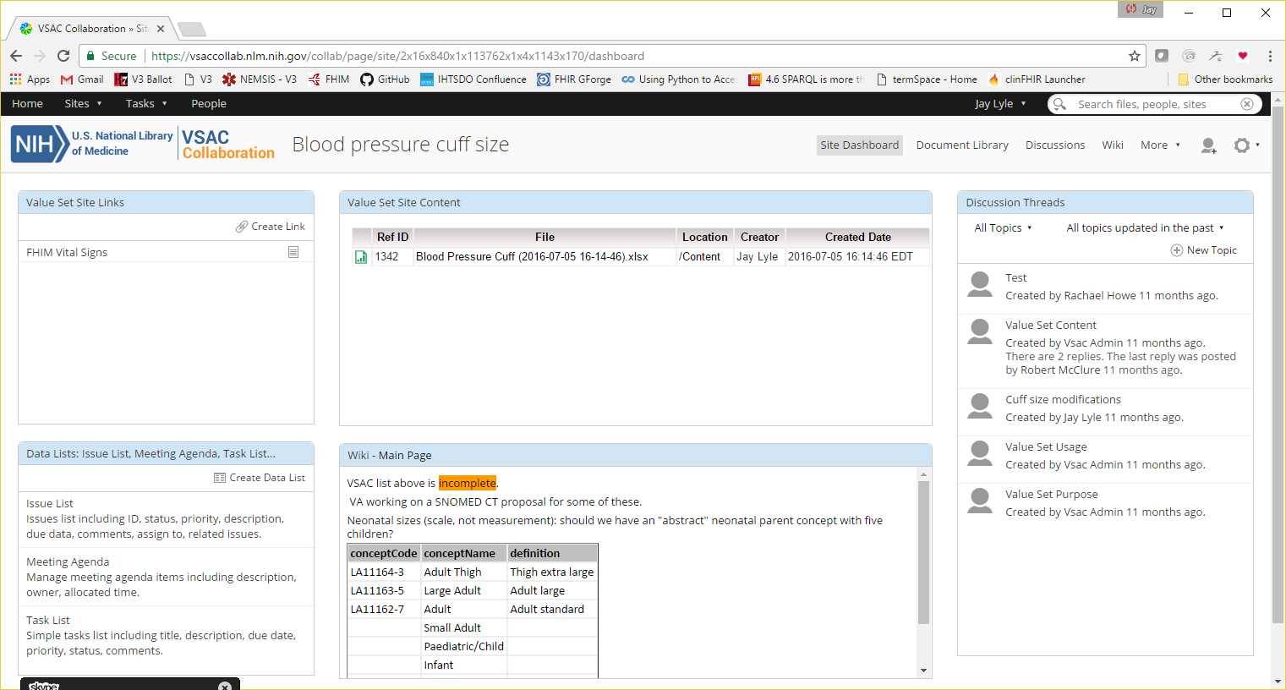
VSAC / Collaboration demo

Slide 12
Jay & Rob: VSAC Repository Support for FHIM Terminology Modeling
Status / Accomplishments / Uses / Value
VSAC publishes value sets, provides rudimentary terminology services
FHIM-authored value sets currently in VSAC:
6 published
6 in review
36 in draft state
FHIM also uses other non-FHIM authored value sets in VSAC
Participants, Other Initiatives
FHIM Team Participants:
Jay Lyle, Rob McClure, Susan Matney, Galen Mulrooney
Non-FHIM Team Key Participants:
VA, FDA, CDC, NCPDP, DICOM, DoD, 3M, Intermountain Healthcare
FHIM value set used elsewhere
Few used in C-CDA, some may be used by FHIR projects. VSAC makes value sets available to others
Strategic Goal, Plans/Timeframe, Resources Required
Provide best available, thoroughly vetted terminology content that can be used in FHIM or any other HIT model
Aligned with overall FHIM timeline
Additional development resources needed to make best use of VSAC functionality
Consider adding to VSAC development resources to gain FHIM-needed development (Collaboration improvement, FHIR alignment, Expression-based value set definitions)
Issues, Risks, and Mitigation
Issues/Risks
VSAC is most focused on meeting CMS eCQM needs
VSAC development is slow
No Expression-based value set definition tools - yet
Slow to introduce some code systems (IP or access issues)
FHIR-terminology service wrappers and de-novo development slow
Mitigations
FHIM can use any service and some content is found elsewhere (PHIN-VADS / FHIR)
Consider standing up FHIR-based FHIM terminology service directly
Jun 15-16 FHA Report-Out

Slide 13
SteveH: HL7 IIM&T Initiative
Current Status, Issues and Activities
STATUS: CIMI WG focus, HL7 IIM&T Project, BMM & CLIM Ballots
ACTIVITIES: Sep 16 HL7 Ballot: Update BMM and add Wound assessment FHIR artifacts
QUESTION-ISSUE: Do we want a January FHIM ballot at HL7 in alignment with CIMI BMM?
ISSUE: Heterogeneous UML Tool (RSA, EA, MagicDraw)
ISSUE: SIGG vs. HL7 CIMI-FHIR tools
Relationship to Other FHIM/FHA/Non-Government Initiatives
DoD DIV conceptual & Logical models being updated IAW FHIM:
CIMI BMM
HL7 EHRS FM Immunization profile IAW FHIM
HL7 (CQI, ONC CQF, CDS) and VA KNARTS
FHIM Team Participants and Non-FHIM Team Key Participants
FHIM Team Participants: Galen, Jay, Rob at CIMI WG
Non-FHIM Team Key Participants:
Gary Dickinson, Julia Chang at HL7 HER WG
Nona Hall at IPO
Nancy Orvis at DoD
Long-Term Goal and Strategy for Achieving Goal
Description: HL7/ISO CLIM & FHIM ballots & FHIR Profiles (see following slide) and Integrated Model Driven Development (MDD) Tools
Estimated Timeframe: 2020-2021
Resources Required: support at HL7 (CIMI, VOCAB, StructuredDocs and ISO TC 215
Other: SIGG direct support of CIMI BMM, DCMs conversion to FHIR Structure Definitions, profiles and extensions
Efficient, Easy, Effective SIGG GUI for clinicians and analysts (non-engineers)
Add additional slides as needed
Jun 13-14 FHIM Discussion Topics

Slide 14
SteveH: HL7 IIM&T Initiative
Status / Accomplishments / Uses / Value
2017 Jan, May, Sep HL7 ballots (CIMI BMM & wound assessment exemplar)
HL7 US Core, FHIR profiles and Extensions generation
CQI QUICK model generation
DoD DIV information models
VA VIM information model alignment
FHIR, Security, CIMI, etc. alignment by FHIM
Participants, Relationship to Other Initiatives
HL7 (CQI, CDS) ONC CQF, VA KNARTS
SOLOR
HL7 PC Skin Assessment
Note: You can adjust quadrant height and width
Strategic Goal, Plans/Timeframe, Resources Required
2018 CIMI STU-1 and FHIR STU-1
2018 FHIM comments ballot
2019 STU-2 and FHIR STU-2
2019 FHIM STU-1
2020 HL7/ISO 2020 CIMI and FHIM standards
2020 Easy, Efficient & Effective MDD Tooling (SIGG and/or HL7) for clinicians, etc.
2020 EHRS FM HL7/ISO ballot integrating FHIM
Issues, Risks, and Mitigation (Resources Required)
FHA or other FHIM Support
HL7 Support
ISO TC 215 support
ONC CQF support
VA KNART Support
VA SOLOR support
Jun 15-16 FHA Report-Out
Notes:
Develop a high yield/ high value and common federal-wide health IT architecture
Promote a defacto national standard by leveraging federal purchasing power
Data exchanged is not based on the same standards
Need to include specific directions for the federal agencies for the ONC’s Interoperability Roadmap
Need to be mutually supportive of each other in HL7 votes
Validate and prioritize the architecture needs identified by FHA and the agencies.
Clarify the level of detail and scope of architecture
Provide the next level of detail that is targeted at a specific need or goal.
Address issues that are common concerns with multiple agencies.
Prepare Transition Plans in support of the next Administration.
Work with agency SMEs to provide an accurate picture of accomplishment in support of the ONC Interoperability Roadmap
Respond to congressional inquiries of the partners
Educate the GAO on achievements in federal health IT
Determine the level of support for CONNECT

Slide 15
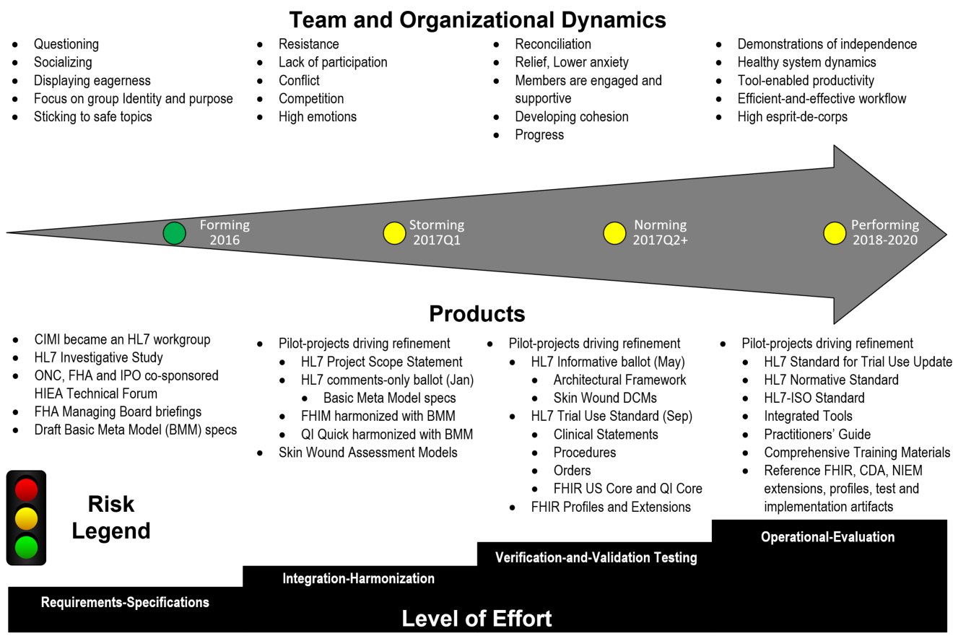
2017Q1 IIM&T Status Schedule is at risk under current resourcing FHIM, SOLOR, CQI, CIMI, SIGG Projects and SMEs need sustained resourcing
15
Integration of Information Models and Tools (IIM&T) project at HL7, resulting in clear, complete, concise, correct, consistent and traceable standards & implementation artifacts, which are easy-to-use by Federal Agencies and their partners, venders and integrators.
See
Notes
Page
HL7 IIM&T Project will produce clear, complete, concise, correct, consistent, traceable and easy-to-maintain standards
and FHIR-CDA-NIEM implementation artifacts for Federal Agencies and their partners, venders and integrators
Notes:
The Integration of Information Models and Tools (IIM&T) project was successfully formed, defining essential requirements, specifications and principles as an Architectural Framework, aka Reference Architecture, of layered-models, to enable the production of clear, complete, concise, correct, consistent, traceable and easy-to-maintain standards and FHIR-CDA-NIEM implementation artifacts developed for Federal Agencies and their partners, venders and integrators; where in 2016,
CIMI transitioned to being an HL7 workgroup in Jan 2016, after having been an IHTSDO workgroup since 2010.
A CIMI-sponsored investigative-study was conducted from Jan thru Sept 2016; where, the investigative-study final-report and draft IIM&T Project Scope Statement (PSS) were delivered at the Sep 2016 HL7 Workgroup meeting for peer-review.
ONC, FHA and IPO co-sponsored a two-day Health Interoperability and Exchange Alliance (HIEA) Technical Forum in Aug 2016 to share the investigative-study results among IIM&T stakeholders-and-proponents and to coalesce issues, recommendations and a way-forward roadmap into a final-report and HL7 PSS.
FHA Managing Board briefings were provided in October and November to obtain Federal Partner concurrence with The HL7 PSS.
CIMI Basic Meta Model (BMM) specifications were formulated for the January comments-only ballot to get peer-review. These were based on OpenEHR and ISO13606 BMM; but, were adapted to be more stable, flexible and easier-to-use.
In 2017Q1 the Pilot-project were used to drive refinement:
HL7 Project Scope Statement was peer-reviewed and updated in-accordance-with HL7 co-sponsoring workgroups feedback.
HL7 comments-only ballot (Jan), which included the CIMI Basic Meta Model specifications
FHIM was harmonized with CIMI BMM
QI Quick was harmonized with CIMI BMM
Skin-Wound Assessment-Models
During the rest of 2017 Pilot-projects drive refinement:
HL7 Informative ballot (May)
Architectural Framework
Skin Wound DCMs
HL7 Trial Use Standard (Sep)
Clinical Statements
Procedures
Orders
FHIR US Core and QI Core
FHIR Profiles and Extensions
2018-2020 Pilot-projects drive refinement
2018 HL7 Standard for Trial Use Update
2019 HL7 Normative Standard
2020 HL7-ISO Standard
Integrated Tools refinement
Practitioners’ Guide updates
Comprehensive Training Materials updates
Reference FHIR, CDA, NIEM extensions, profiles, test and implementation artifacts refined and updated

Slide 16
FHIM within HL7
FHIM within the CIMI-sponsored HL7 IIM&T project is working in alignment with other HL7 workgroups, The Open Group Healthcare Forum and HSPC with a computable semantic-interoperability goal and objective to minimize the need for traditional and expensive Extraction, Transformation and Load (ETL) mappings and tools and federated governance. These standardized artifacts are collectively referred to as the HL7 Clinical Logical Information Model (CLIM); where, CLIM is a package of CIMI architectural-framework harmonized LIMs (e.g., SOLOR, FHIM, QUICK, DCM, eCQM, KNART and CDA, V2, V3, FHIR (US CORE, QI Core, Profiles and Extensions), etc.) and Platform-Specific Models (PSMs). Traditional LIM-and-PSM development-strategies are typically incomplete and inconsistent; where, the Figure 1 IIM&T Model Driven Development Strategy and the subsequent article address this problem. The Open Group Healthcare Forum collaboration is among industry stakeholders, regulatory bodies, other standards-setting organizations, and other consortia concerned with healthcare interoperability.
Governance involves change control, configuration management and version control; where, CLIM governance is generally federated. That is, local development organizations govern their own artifacts and may wish to provide versions to HL7. Appropriate HL7 workgroups govern HL7 artifacts and ballots. Similarly, FHIR governance is generally federated; where, local development organizations govern their own artifacts and may wish to provide versions to HL7. At HL7, FHIR-compliant reusable-artifacts are governed by the FHIR workgroup’s HL7 artifacts and ballots.
Jun 13-14 FHIM Discussion Topics

Slide 17
Health IT Goal: Computable Semantic-Interoperability where, this figure shows the FHIR artifact development process, using the IIM&T process.
FHIM, using SMEs,
Standards,
US Regulatory Requirements
CQI, using SMEs,
CQF, vMR & QDM
Requirements
CIMI, using SMEs,
FHIM & CQI
Domain Models
CIMI Principles & Reference Models
CIMI Principles & Reference Models
CIMI Principles & Reference Models
FHIM
Domain Models
QI Quick & DAF
Domain Models
CIMI DCMs
CQI eCQMs
CDS KNARTs
Common Stakeholders
SOLOR Terminology Editor
SNOMED CT, LOINC and RxNorm Semantics
VSAC Terminology Server
Manual or using Tools
Manual or using Tools
Manual or using Tools
Interoperability Specifications and Implementation Artifacts
CDA, NIEM, FHIR (US Core, QI Core, Profiles, Extensions)
See
Notes
Page
HL7 IIM&T Project will produce clear, complete, concise, correct, consistent, traceable and easy-to-maintain standards
and FHIR-CDA-NIEM implementation artifacts for Federal Agencies and their partners, venders and integrators
Notes:
The benefit of standard CIMI Principles and Reference Models is an Architectural Framework for computable semantic-interoperability aka interpretability across time, locations, systems and care contexts, assuming the re-usable “stack” is standardized and has widespread implementation. Seamless tools can result in efficiency and effectiveness. This information-model “stack” foundation is mission-essential for
collection, communication, aggregation and interpretation of patient data to accelerate secondary uses in public health, disease surveillance, post-approval monitoring, and patient-centered outcomes research.
health-related services including telecare, clinical decision support, research, and quality measurement, improving healthcare access, quality, and uniformity.
patients, clinicians, and the public to realize major benefits from improved care coordination, reduction of medical errors, and decreased costs resulting in healthier lives.

Slide 18
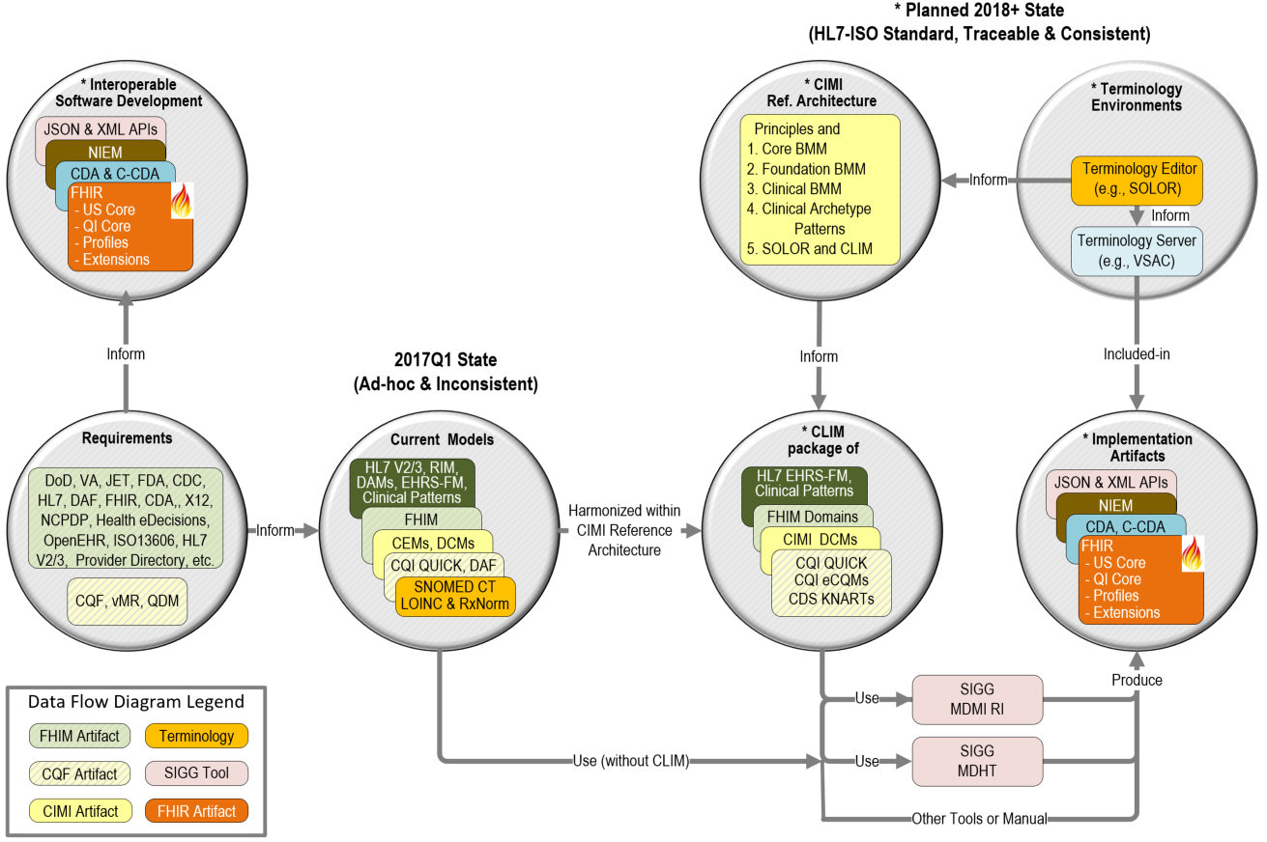
Strategy Collaboration of government, industry and academic SMEs where, hope is not a strategy, luck is not a factor and ignorance is not bliss
See
Notes
Page
HL7 IIM&T Project will produce clear, complete, concise, correct, consistent, traceable and easy-to-maintain standards
and FHIR-CDA-NIEM implementation artifacts for Federal Agencies and their partners, venders and integrators
Notes:
Tool-strategy
Model Driven Development methodologies to go from FHIM, QI Quick and other domain models (financial, logistics, etc.) to FHIR Structure Definitions are under evaluation.
FHIR Structure Definitions are used to describe the underlying resources, data types, terminology bindings and value sets used to specify FHIR extensions and profiles.
This can be done with SIGG, commercial or custom tools.
This can be done with or without using ISO 13606 Architype Description Language (ADL)
Open-source SIGG, Sparx EA, IBM RSA, Magic Draw each can be the base tool
Additional resources are needed to develop (e.g., SIGG clinical analysts’ user interfaces, MDMI, MDHT upgrades), test and properly document the tool (s).
The benefit of having the FHIR extension and prototype process contained in one easy-to-use model-driven-development tool, such as the open-source SIGG, is the ability for clinical analysts to maintain clear, complete, concise, correct, consistent and traceable standards & implementation artifactsfor Federal Agencies and their partners, venders and integrators.

Slide 19
Attributes of Success
Information model and Tooling Mapping versus development distinction and respective Utility
Jump start projects and standards development efforts with (formal) information Modeling Assets
Advocacy to support follow-on efforts / Implementation Practicality
Sustain Core SME Framework / Expand / Invest in building upon current SME base
Apply insights / recommendations from all efforts to date, e.g., Info Modeling Tech Forum
Build out near term, mid term & long term efforts with Pilots
Assess / layout resourcing implications tied to report
Capitalize on collaboration with FHIR colleagues and maintain Process Engagement Strategy
Quarterly reporting to maintain predictable stakeholder contact, awareness and engagement
Promote HL7 Balloted CLIM & SIGG-tools use by EHR developers, implementers and vendors
Expand Communications / Outreach; Governance; Strategic Interoperability Planning
Supportive of Integration
Leverage opportunities to expand FHIM usability and use by larger communities, e.g., HL7
Repurpose efforts / Replace building models to build models via active engagements
Enhance SME base, User Community Partnerships & Stakeholder Community Contacts
Guide a shifting in commitments & to gauge progress.
HL7 IIM&T Project will produce clear, complete, concise, correct, consistent, traceable and easy-to-maintain standards
and FHIR-CDA-NIEM implementation artifacts for Federal Agencies and their partners, venders and integrators

Slide 20
Day 1 Key FHA Report Out Items (Please see note section for additional details)
Description (Status)
1
2
3
4
5
6
7
Jun 13-14 FHIM Discussion Topics
Notes:
FHIM CONOPS report in review by FHA
Closed
Closed
Eric/Ian – Meet with DMDC for final comments. Present at Learning Series
NLM is developing clear requirements
Federal partners decided to delay until Fall 2016. ONC will have the lead.

Slide 21
Sean: Support for FHIR Implementations
Current Status, Issues and Activities
Relationship to Other FHIM/FHA/Non-Government Initiatives
FHIM Team Participants and Non-FHIM Team Key Participants
FHIM Team Participants:
Non-FHIM Team Key Participants:
Long-Term Goal and Strategy for Achieving Goal
Description:
Estimated Timeframe:
Resources Required:
Other
Add additional slides as needed
Jun 13-14 FHIM Discussion Topics

Slide 22
Sean: Support for FHIR Implementations
Status / Accomplishments / Uses / Value
Currently no direct support for any specific FHIR implementations
Participants, Relationship to Other Initiatives
JET FHIR IPO
Mapping C-CDA on FHIR to C-CDA
MDHT
MDMI
Note: You can adjust quadrant height and width
Strategic Goal, Plans/Timeframe, Resources Required
Generate FHIR profiles from FHIM/CIMI
Issues, Risks, and Mitigation
CIMI
Terminology
Jun 15-16 FHA Report-Out

Slide 23
Sean: Tooling
Current Status, Issues and Activities
Relationship to Other FHIM/FHA/Non-Government Initiatives
FHIM Team Participants and Non-FHIM Team Key Participants
FHIM Team Participants:
Non-FHIM Team Key Participants:
Long-Term Goal and Strategy for Achieving Goal
Description:
Estimated Timeframe:
Resources Required:
Other
Add additional slides as needed
Jun 13-14 FHIM Discussion Topics

Slide 24
Sean: Tooling
Status / Accomplishments / Uses / Value
Update terminology stereotype to support updated HL7 Terminology Binding Syntax
Participants, Relationship to Other Initiatives
MDHT
MDMI
JET FHIR IPO
Mapping C-CDA on FHIR to C-CDA
SIGG
Note: You can adjust quadrant height and width
Strategic Goal, Plans/Timeframe, Resources Required
Expand Terminology Support
FHIR Terminology Service Integration (VSAC)
Issues, Risks, and Mitigation
VSAC
Lack of FHIR Terminology Services
Continuing with RSA support
Jun 15-16 FHA Report-Out

Slide 25
FHIM Transition Planning
Current Status, Issues and Activities
Relationship to Other FHIM/FHA/Non-Government Initiatives
FHIM Team Participants and Non-FHIM Team Key Participants
FHIM Team Participants:
Non-FHIM Team Key Participants:
Long-Term Goal and Strategy for Achieving Goal
Description:
Estimated Timeframe:
Resources Required:
Other
Add additional slides as needed
Jun 13-14 FHIM Discussion Topics

Slide 26
FHIM Transition Planning
Status / Accomplishments / Uses / Value
Participants, Relationship to Other Initiatives
Note: You can adjust quadrant height and width
Strategic Goal, Plans/Timeframe, Resources Required
Issues, Risks, and Mitigation
Jun 15-16 FHA Report-Out
Notes:
Develop a high yield/ high value and common federal-wide health IT architecture
Promote a defacto national standard by leveraging federal purchasing power
Data exchanged is not based on the same standards
Need to include specific directions for the federal agencies for the ONC’s Interoperability Roadmap
Need to be mutually supportive of each other in HL7 votes
Validate and prioritize the architecture needs identified by FHA and the agencies.
Clarify the level of detail and scope of architecture
Provide the next level of detail that is targeted at a specific need or goal.
Address issues that are common concerns with multiple agencies.
Prepare Transition Plans in support of the next Administration.
Work with agency SMEs to provide an accurate picture of accomplishment in support of the ONC Interoperability Roadmap
Respond to congressional inquiries of the partners
Educate the GAO on achievements in federal health IT
Determine the level of support for CONNECT

Slide 27
Today’s FHIM Situation
Near term (next 90 days)
Wrap up current projects
Prepare for a shift in focus
Prepare Transition Plan
Engage in purposeful, effective communications
Long term
Create a 5 year vision for FHA
Create the infrastructure to support architecture across the federal health IT space
Identify and engage stakeholders and market influencers
Identify potential shared services
Identify and work on major work streams
Jun 13-14 FHIM Discussion Topics
Notes:
Use brief bullets and discuss details verbally.

Slide 28
Day 1 Key FHA Report Out Items (Please see note section for additional details)
Description (Status)
1
2
3
4
5
6
7
Jun 13-14 FHIM Discussion Topics
Notes:
FHIM CONOPS report in review by FHA
Closed
Closed
Eric/Ian – Meet with DMDC for final comments. Present at Learning Series
NLM is developing clear requirements
Federal partners decided to delay until Fall 2016. ONC will have the lead.

Slide 29
Acronyms
BMM | CIMI Basic Meta Model components | ISAAC | VA tool for SOLOR
CEM | Intermountain Clinical Element Models | ISO | International Standards Organization
CIMI | HL7 Clinical Information Model Initiative | JIF | VA/DOD Joint Incentive Fund
CLIM | HL7 Common (Clinical) Logical Information Model | KNART | CDS Knowledge Artifact
CQI | HL7 Clinical Quality Information | LOINC | Logical Observation Identifiers Names and Codes
CQF | HL7 Clinical Quality Framework | MDHT | Model Driven Health Tools
DAF | ONC Data Access Framework | MDMI | Model Driven Message Interoperability
DCM | Detailed Clinical Model | ONC/OST | US Office of the Natl. Coordinator / Office of Science and Tech.
eCQM | CQI Electronic Clinical Quality Measure | PMP | Program Management Plan
STU | HL7 Standard for Trial Use | PSS | Project Scope Statement
EDW | Electronic Data Warehouse | QUICK | CQI Quality Information and Clinical Knowledge logical model.
FDA | US Federal Drug Agency | RXNORM | US National Library of Medicine naming system for drugs
FHA | US Federal Health Architecture | SIGG | Standards Interoperability Guide Generator
FHIM | US Federal Health Information Model | SOLOR | SNOMED extension for LOINC & RXNorm
FHIR | HL7 Fast Health Information Resource | TLC | ONC/OST Technical Learning Center
HIEA | DoD VA IPO Health Interoperability Exchange Alliance | VA | US Veterans Administration
HcDir | ONC-FHA Provider Healthcare Directory. | VCS | Version Control System for collaboration
IPO | US DoD and VA Interagency Program Office | VSAC | NLM Value Set Authority
See Notes Page
Notes:
BMM is CIMI Basic Meta Model components See http://wiki.hl7.org/index.php?title=CIMI_Practitioners%27_Guide
CDA is HL7 Clinical Data Architecture. See http://www.hl7.org/implement/standards/product_brief.cfm?product_id=258
C-CDA is HL7 Consolidated CDA. See http://www.hl7.org/implement/standards/product_brief.cfm?product_id=379
CEM is Intermountain Clinical Element Models e http://www.opencem.org/#/
CDS is HL7 Clinical Decision Support workgroup. See http://wiki.hl7.org/index.php?title=Clinical_Decision_Support
CIMI is HL7 Clinical Information Model Initiative. See http://wiki.hl7.org/index.php?title=Clinical_Information_Modeling_Initiative_Work_Group
CIMI Principles See http://wiki.hl7.org/index.php?title=CIMI_Practitioners%27_Guide
CIMI Reference Models (aka Information Architecture) See http://wiki.hl7.org/index.php?title=CIMI_Practitioners%27_Guide
CLIM is HL7 Clinical Logical Information Model Package of CIMI-Harmonized SOLOR, FHIM, CQF, CIMI DCMs and CQI KNARTs
where, independent organizations maintain the component models and HL7 periodically configuration manages, ballots and standardizes them.
CQF is ONC Clinical Quality Framework. See http://wiki.hl7.org/index.php?title=Clinical_Decision_Support
CQI is HL7 Clinical Quality Information workgroup. See http://wiki.hl7.org/index.php?title=Clinical_Quality_Information
DAF is ONC Data Access Framework (US Core). See http://wiki.siframework.org/Data+Access+Framework+Homepage
DCM is CIMI Detailed Clinical Models. See http://www.opencimi.org/model-browser
eCQM is Electronic Clinical Quality Measure
FHIM is Federal Health Information Model; where, FHIM specifies healthcare domains and their data modules and their data elements. http://FHIMS.org
FHIR is HL7 Fast Healthcare Information Resource standard and workgroup. See http://wiki.hl7.org/index.php?title=FHIR
HcDir is ONC-FHA Provider Healthcare Directory. See http://wiki.siframework.org/Provider+Directories
IIM&T Is CIMI-sponsored HL7 Integration of Information Models & Tools Project. http://wiki.hl7.org/index.php?title=CIMI_Practitioners%27_Guide
JET is DoD-VA Joint Exploratory Team.
KNART is CDS Knowledge Artifact. See http://www.hl7.org/implement/standards/product_brief.cfm?product_id=337
MDHT is SIGG Model Driven Health Tool. See https://projects.eclipse.org/proposals/model-driven-health-tools
MDMI is SIGG Model Driven Message Interoperability.
The present MDMI Referent Index (RI) scope is the US Core; where, FHIM is used for data-element value-sets.
FHA’s MDMI RI supports all MU2 data elements and >90% of the C-CDA model.
See http://www.omg.org/mdmi/ and http://www.omg.org/spec/MDMI/ and https://github.com/MDMI/ReferentIndexContent
NIEM is National Information Exchange Package. It provides browser-cased “interoperability” among Federal agencies. See https://www.niem.gov/
QI Core is FHIR Quality Improvement Core Implementation Guide . See https://www.hl7.org/fhir/qicore/qicore.html
QUICK is CQI Quality Information and Clinical Knowledge logical model.
See https://www.hl7.org/documentcenter/public_temp_315E0F18-1C23-BA17-0C73398BA144AB5D/wg/cqi/Defining_eCQMs_Using_CQL.pdf
RI is SIGG-MDMI Referent Index. See https://github.com/MDMI/ReferentIndexContent
SIGG is FHA Standards Implementation Guide Generator
SOLOR is VA’s SnOmed LOinc, Rxnorm; where, HSPC hosts the SOLOR project to provide the terminology foundation for model development.
VSAC is NLM Value Set Authority Center. https://vsac.nlm.nih.gov/

Slide 30
Reference Documents
HL7 IIM&T Project Scope Statements https://1drv.ms/f/s!AlkpZJej6nh_lIQOuPJcL2rf5BVoXQ
IIM&T Technical Forum Summary https://1drv.ms/w/s!AlkpZJej6nh_k9gyRVADgOvM5SlJkQ
IIM&T Work Breakdown Structure https://1drv.ms/f/s!AlkpZJej6nh_lKc00J3Kh2BTkopPnA
IIM&T Briefing Slides https://1drv.ms/p/s!AlkpZJej6nh_k9dE-b_DAO8HSNNT6Q
IIM&T Newsletters http://wiki.hl7.org/index.php?title=CIMI_Newsletters
IIM&T Reports https://1drv.ms/w/s!AlkpZJej6nh_k9dQ2qQnRuQM8gbu8A
CIMI web-site https://www.opencimi.org
CIMI BMM Browser http://models.opencimi.org/cimi_doc/
CIMI Architype-Model Browser https://www.opencimi.org/model-browser
CIMI Wiki http://wiki.hl7.org/index.php?title=Clinical_Information_Modeling_Initiative_Work_Group
CIMI Minutes http://wiki.hl7.org/index.php?title=CIMI_Minutes
CIMI Ballot Materials https://drive.google.com/drive/folders/0ByrVwEEPQjMyazNLMUNFZ2YtNk0
CIMI Architecture and Style Guides http://wiki.hl7.org/index.php?title=CIMI_Modeling,_Architecture,_Methodology_and_Style_Guides
CIMI Practitioners Guide http://wiki.hl7.org/index.php?title=CIMI_Practitioners%27_Guide
US CORE Wiki https://oncprojectracking.healthit.gov/wiki/display/TechLabSC/DAF+Home
Skin and Wound Assessment Pilot Wiki http://wiki.hl7.org/index.php?title=PC_CIMI_Proof_of_Concept
SNOMED CT: http://ihtsdo.org/index.html
Expression Constraint Guide https://confluence.ihtsdotools.org/display/DOCECL/Expression+Constraint+Language+-+Specification+and+Guide Some networks block the use of clickable links; where, you must copy the link into a browser to access the content.
If links don’t work on a Government Network or VPN, try accessing them directly (without VPN)

Slide 31
Backup Slides
FHA & FHIM Overview
Jun 13-14 FHIM Discussion Topics

Slide 32
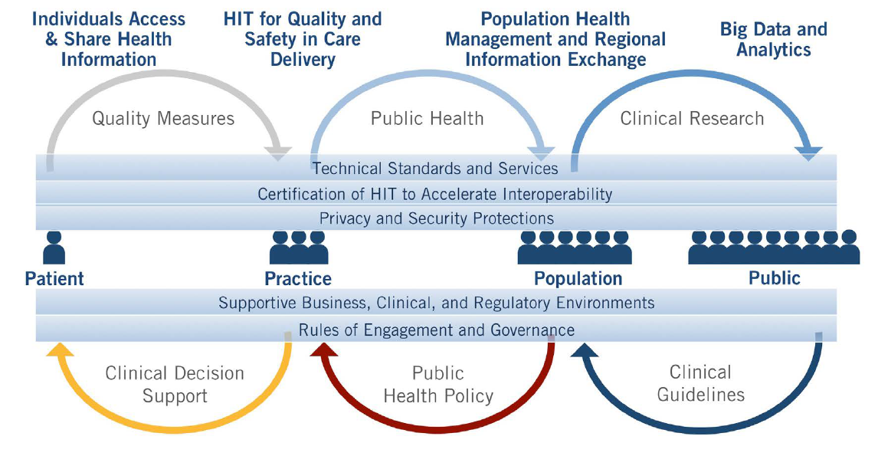
Health IT Ecosystem
Source: 2017 FHA Strategic Plan

Slide 33
Initiative Relationships
Big Data
Data Format (C-CDA, FHIR)
Transport [Direct/Connect/Rest(FHIR)]
Mobile Health
Telemedicine
Patient Consent
Metrics
SOLOR
Common Data Elements
FHIM / CIMI
Patient ID / Matching
Trust (HcDir, Trust Framework)
Security
Infrastructure (Cloud)
Source: 2016-01-06 FHA Managing Board Brief

Slide 34
Agency Priorities
HHS OCIO | SSA | CMS | DoD | VA
Cloud Computing | Patient Consent / Authorization | Link Payment with Service | Patient Identification | Common Trust Framework
Security | Provider Directory | Consolidated CDA | Patient Matching | Patient Identification
Dig Data | Patient Matching | Direct as-a Service | Security | Patient Matching
Telemedicine | Patient Identification | Data Format | Consolidated CDA | Provider Directory
Mobile Health | Common Trust Framework | FHIR | Data Format | Patient Consent / Authorization
Source: 2016-01-06 FHA Managing Board Brief
Notes:
VA listed Patient Identification and Patient Matching as shared Priority 2 because they feel that one cannot be done without the other.

Slide 35
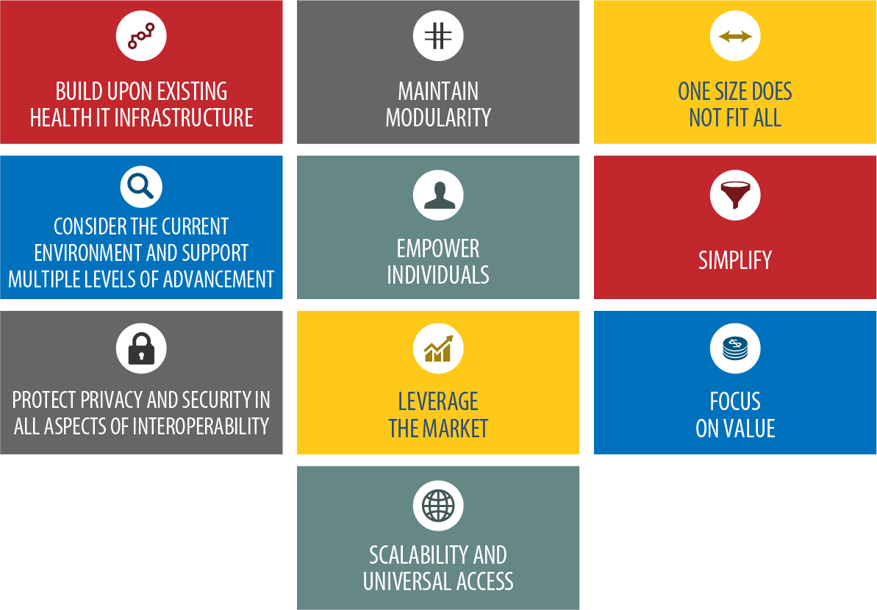
ONC: Principles of Interoperability
Source: 2017 FHA Strategic Plan

Slide 36
FHIM Purpose
Develop information and implementation models to fully support health computable semantic-interoperability and improve the quality of the information by harmonizing the information from the individual federal partners and standards organizations into a healthcare common logical information model. FHIM supports model driven development (MDD) tools and methodologies to generate clear, complete, correct, concise, consistent and fully-traceable computable semantically-interoperability specifications thereby reducing the cost of producing information exchange standards, artefacts and implementations.
Deliverable: HL7/ISO Common Logical Information Model (CLIM) standard, which can reduce the costly mapping sustainment costs across Federal and partner systems.

Slide 37
FHIM Background
The FHIM team has completed modeling 22 of 35 information domains, including the domains that support 80-85% of the health information currently being exchanged
The FHIM team has integrated the FHIM with tools (MDHT and MDMI) that can automate most of the processes for producing draft health information exchange standards and that can support and improve the efficiency with which federal partners develop information exchange implementations. Additionally detailed analyst artifacts are produced.
All of this work is ready to be fully tested to verify the data quality and cost reductions that can be achieved
Shared clinical-information requires computable semantic-interoperability for clinical decision support and population-based reasoning. FHIM is part of the collaborative IIM&T model-driven-development tool-enforced methodology to construct consistent, traceable and re-usable HL7 FHIR, CDA, V2 and V3 messages plus JSON APIs, NIEM etc. specifications, implementation guides, implementation-artifacts and component-based architectural building-blocks, such as HSPC SMART. The evolving IIM&T methodologies-and-technologies are the key-facets to efficient-and-effective shared-data and plug-and-play Healthcare Information Technology (HIT) interoperability. The FHIM Logical Information Model (LIM) within the CIMI Architectural Framework (aka Reference Architecture) creating Detailed Clinical Models (DCMs) to improve HIT Platform-Specific Model (PSMs) implementation-interoperability.

Slide 38
FHIM ROI
Improved Federal Agencies, vendors, partners and contractor HIT development efficiency-and-effectiveness:
As much as a 50% reduction in time it takes to develop, ballot and generate an approved HIE standard
More than a 50% reduction in the time it takes to develop HIE implementations
Supports the generation of large numbers of CIMI DCM’s - reduction of more than 50%
Supports consistency and traceability from mission needs (requirements) to implementation (e.g., HL7 V3 CDA, FHIR, JSON APIs, NIEM, etc.)
The three improvements above are achieved by:
Reducing time and risk associated with harmonizing information models across federal partners (e.g., align federal partner medication information based on FDA requirements)
Reducing time needed to harmonize information across multiple projects within a single federal partner
Reducing the need to do mappings on patient-level information and automating the mapping process, including the ability to independently test the mappings
Reducing time needed to coordinate with other federal partners on ballots
Provides the single forum for federal partners to meet and discuss healthcare information modeling and the terminology needed to support it

Slide 39

FHIM Overview
Common Vision and Strategy
Clarify the common vision and strategy for the future state of federal health IT
VISION
(Patient Centered; Learning Health Systems; Precision Medicine Initiative)
Forum to Address Federal Health Challenges
Provide a forum for federal health IT stakeholders to collaborate and coordinate on current and future health IT challenges
(Communications, PMO, Learning Series)
UNIFIED FEDERAL VOICE
Federal Health IT Ecosystem
Provide information on the current and future landscape of federal health IT to improve decision making across the Federal Government
(Patient Matching, Decision Support Tools, others)
Shared Services and Products
Develop and manage shared services and products to support federal health IT partners
(CONNECT, Direct Exchange, FHIM, VSAC)
ARCHITECTURE

Slide 40
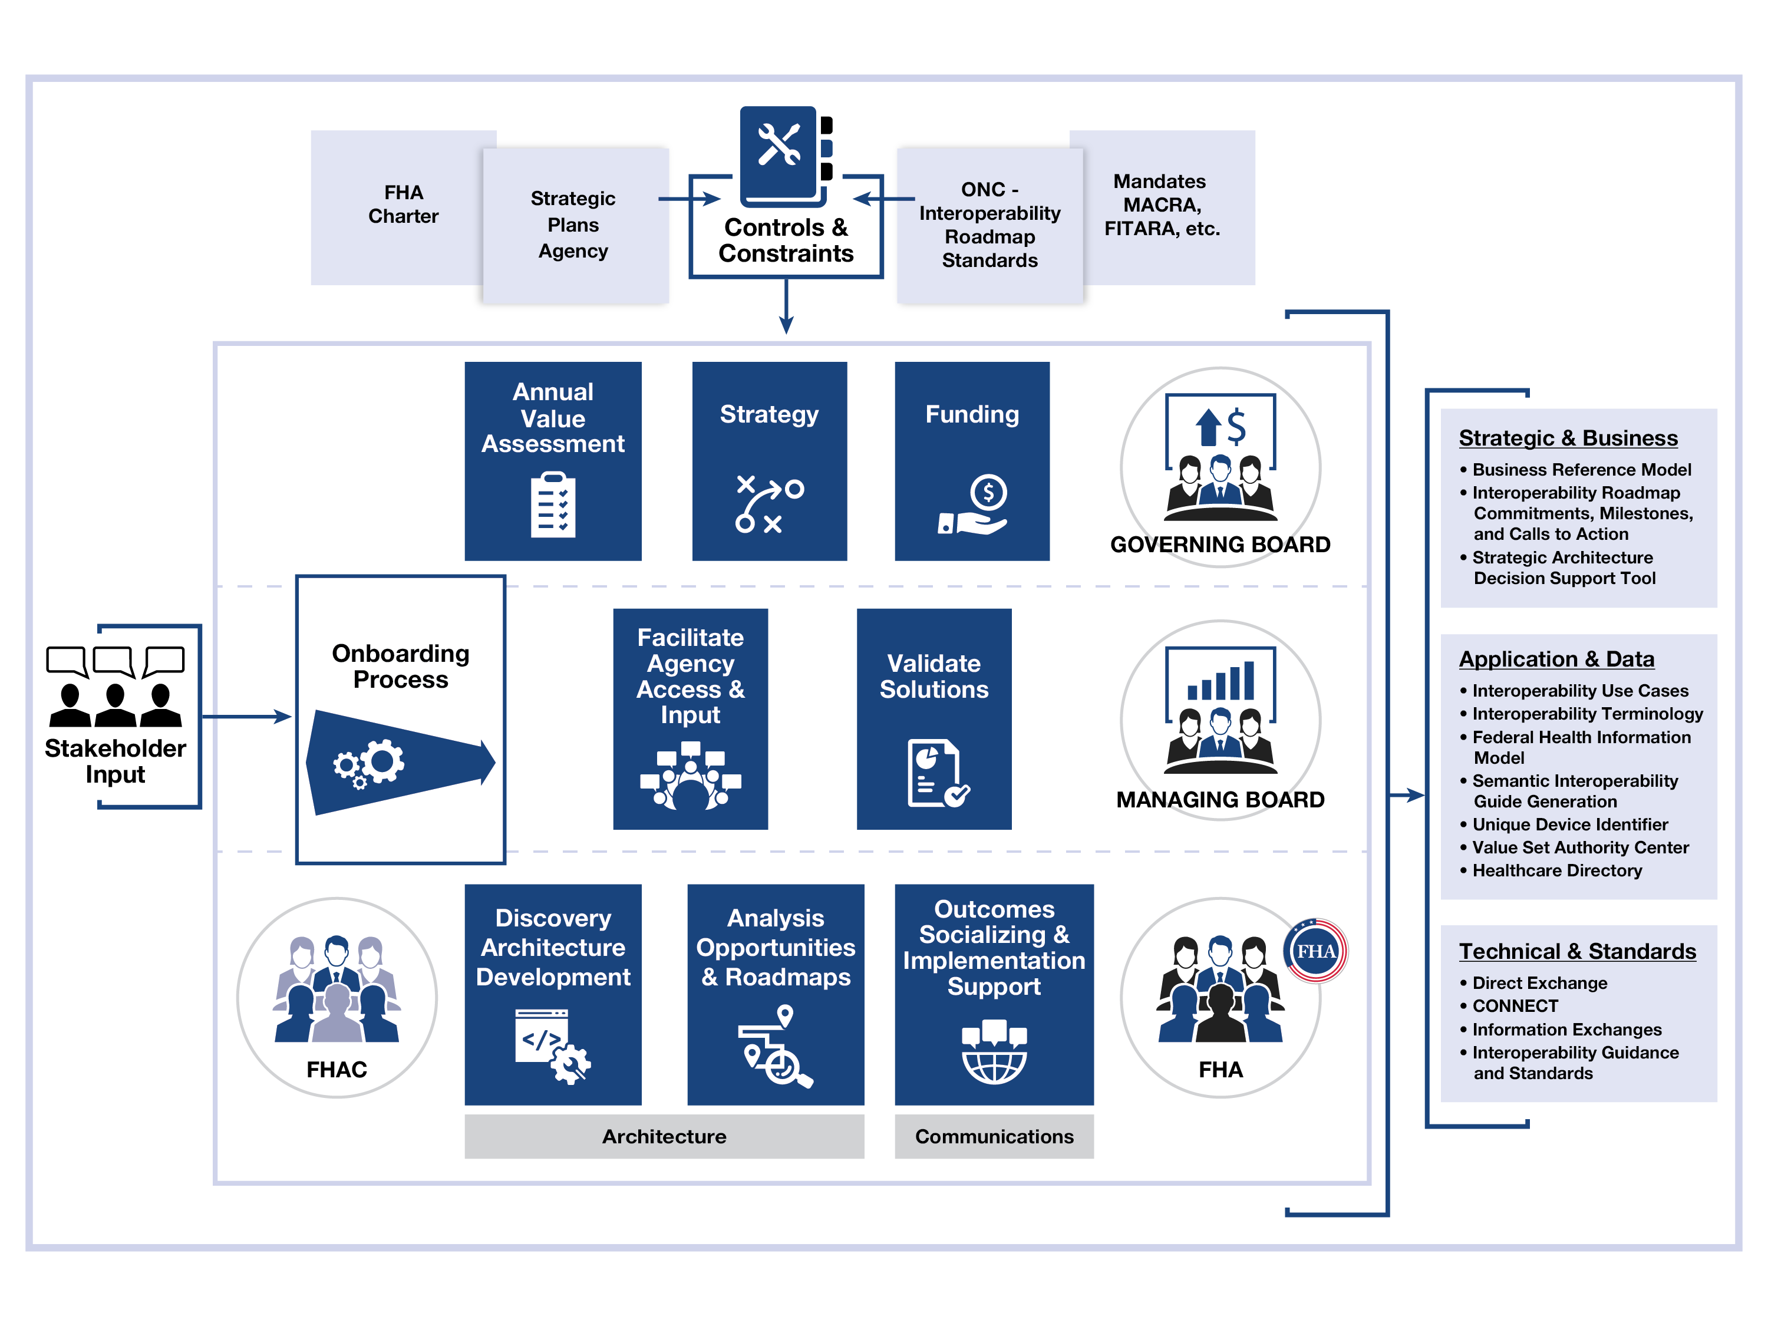
FHIM Concept of Operations (CONOPS)
Notes:
FHA will:
Develop and implement an on boarding and exiting process
Develop an Annual Value Assessment tool for the Governing Board
Revise Governing Board Charter
Revise Managing Board Charter
Approve the revised FHA CONOPS
Engage Stakeholders with a revised engagement plan
Engage the FHIT Coordinating Council
Leverage the Federal Health Architects Council (FHAC) by engaging a purposeful approach
Authoritative sources of information like S&I are included as an input from the Stakeholders
Clarify Validate Solutions.
-similar to CONNECT
-Identify how we are present/validate on a quarterly approach
-e.g. FHIM, HcDir, VSAC
-is there a better word than Solutions
KEY ROLE: Identify and develop national/federal (harmonized) HIT standards
Sep box for IO Roadmap and assoc standards (?)
We won’t be developing standards. We work with SDOs to create harmonized standards that support federal/national priorities.

Slide 41
Onboarding New Work
45 days
15 days
1. FHA, MB or GB Challenge Proposal
2. Onboarding
Process
3. Analyze & define approach
4. Estimate timing & resources
5. MB Review & Approval
Onboarding
Process
Strategic Alignment
Identify Issues
Group Issues
Prioritize Groups
Notes:
1) Any new work for FHA comes in through the onboarding process. The entry point could be via the Governing Board or the Managing Board (at the request of the Governing Board).
2) The scope of the work is set through the Kaizen process, which involves FHA and the Managing Board.
Step One: does the requested work align with FHA’s strategic plan? Must answer YES to each of the following, to align (note that this list is not definitive):
· Is it something that can be addressed by architecture and architectural analysis?
· Is it something that has potential impact across the Federal health ecosystem, or is it for a single agency?
· Does it fall within the pillars of the FHA architecture – person centric, learning health, precision medicine?
· Is it a high yield/high value challenge?
Steps Two and Three: These two steps are your basic Agile planning/Affinity Grouping exercise. All members of the Kaizen team (Managing Board, FHA, others as invited) identify issues that they associate with the initiative from step one, on post-it notes, and stick them on a board. Once that is done, the team works through the issues, grouping them to identify ones that are identical, or subsets or supersets of each other, and then further grouping issues that might otherwise be related.
Step Four: here the Onboarding team reviews the groups of issues, and prioritize them. Whichever group comes out on top becomes the first new initiative to go through the remainder of the onboarding process.
3) FHA analyzes the issues identified in the issue prioritized in the Kaizen. This involves reaching out to the agencies, MITRE, etc. to further identify and drill down on the issues. In this stage we should be able to identify any agencies or groups that are already working in any of the areas of concern (quick wins) and also gaps or areas that are not being considered anywhere. Based on these findings, a plan of attack is developed, to close the gaps etc.
4) FHA estimates the level of effort and timing to complete the work in the plan of attack. This will include considerations of any overlap or impact that this work may have on existing initiatives. Steps 1 through 4 take an estimated 45 days to complete, at which point the results, plan, estimates etc. are passed to the Managing Board to review
5) At the next Managing Board meeting (15 days approximately after step 4 is completed), the initiative is reviewed and approved or rejected.
NOTES: from the start of the onboarding process to approval is approximately 60 days, which coincides with the Managing Board meeting cycle.
New initiative requests can be introduced to the onboarding process at Managing Board meetings – so you could expect to see a timeline along the following lines:
Day 0: First initiative request made at Managing Board meeting #1
Day 30: Second initiative request made at Managing Board meeting #2
Day 60: First initiative reviewed and approved at Managing Board meeting #3; Third initiative request made
Day 90: Second initiative reviewed and approved at Managing Board meeting #4
Day 120: Third initiative reviewed and approved at Managing Board meeting #5; Fourth initiative request made.

Slide 42
FHIM Lifecycle
This table shows the project lifecycle steps involved in doing a typical inter-agency data-sharing project; where, notional small to large project times reflect the traditional “start from a blank sheet of paper” approach to the FHIM and SIGG( MDHT + MDMI) reusable Model Driven Architecture (MDA) approach; where the difference in efficiency and effectivity will produce a significant cost savings by using maintain the available FHIM and SIGG.
Step | Notional Traditional Time | Notional FHIM Time
information Exchange Requirements (IERs) analysis Identify data modules, elements, dictionary, provenance and meta-date Identify terminologies, value sets for coded data attributes, any additional information Define most appropriate terminologies and value sets for coded data attributes | 1-4 weeks by SME team | 1-4 hours by an SME
Interoperability Specification (IS) production Identify specific use cases for information exchange implementation Constrain the IER data and terminology to support the use cases Generate the implementation specific model (CDA, FHIR, etc.) | 1-4 weeks by analyst | 1-4 hours by analyst
IS Implementation Guides (IGs) (e.g., CDA/FHIR profiles) production | 1-4 weeks by SME | 1-4 hours by SME
IS IG profile testing | 1-4 days | 1-4 hours
IS IG ballot/standardization at an SDO | 1-4 weeks | 1-4 hours
Notes:
1) Any new work for FHA comes in through the onboarding process. The entry point could be via the Governing Board or the Managing Board (at the request of the Governing Board).
2) The scope of the work is set through the Kaizen process, which involves FHA and the Managing Board.
Step One: does the requested work align with FHA’s strategic plan? Must answer YES to each of the following, to align (note that this list is not definitive):
· Is it something that can be addressed by architecture and architectural analysis?
· Is it something that has potential impact across the Federal health ecosystem, or is it for a single agency?
· Does it fall within the pillars of the FHA architecture – person centric, learning health, precision medicine?
· Is it a high yield/high value challenge?
Steps Two and Three: These two steps are your basic Agile planning/Affinity Grouping exercise. All members of the Kaizen team (Managing Board, FHA, others as invited) identify issues that they associate with the initiative from step one, on post-it notes, and stick them on a board. Once that is done, the team works through the issues, grouping them to identify ones that are identical, or subsets or supersets of each other, and then further grouping issues that might otherwise be related.
Step Four: here the Onboarding team reviews the groups of issues, and prioritize them. Whichever group comes out on top becomes the first new initiative to go through the remainder of the onboarding process.
3) FHA analyzes the issues identified in the issue prioritized in the Kaizen. This involves reaching out to the agencies, MITRE, etc. to further identify and drill down on the issues. In this stage we should be able to identify any agencies or groups that are already working in any of the areas of concern (quick wins) and also gaps or areas that are not being considered anywhere. Based on these findings, a plan of attack is developed, to close the gaps etc.
4) FHA estimates the level of effort and timing to complete the work in the plan of attack. This will include considerations of any overlap or impact that this work may have on existing initiatives. Steps 1 through 4 take an estimated 45 days to complete, at which point the results, plan, estimates etc. are passed to the Managing Board to review
5) At the next Managing Board meeting (15 days approximately after step 4 is completed), the initiative is reviewed and approved or rejected.
NOTES: from the start of the onboarding process to approval is approximately 60 days, which coincides with the Managing Board meeting cycle.
New initiative requests can be introduced to the onboarding process at Managing Board meetings – so you could expect to see a timeline along the following lines:
Day 0: First initiative request made at Managing Board meeting #1
Day 30: Second initiative request made at Managing Board meeting #2
Day 60: First initiative reviewed and approved at Managing Board meeting #3; Third initiative request made
Day 90: Second initiative reviewed and approved at Managing Board meeting #4
Day 120: Third initiative reviewed and approved at Managing Board meeting #5; Fourth initiative request made.

Slide 43
Onboarding New Work
45 days
15 days
1. FHA, MB or GB Challenge Proposal
2. Onboarding
Process
3. Analyze & define approach
4. Estimate timing & resources
5. MB Review & Approval
Onboarding
Process
Strategic Alignment
Identify Issues
Group Issues
Prioritize Groups
Notes:
1) Any new work for FHA comes in through the onboarding process. The entry point could be via the Governing Board or the Managing Board (at the request of the Governing Board).
2) The scope of the work is set through the Kaizen process, which involves FHA and the Managing Board.
Step One: does the requested work align with FHA’s strategic plan? Must answer YES to each of the following, to align (note that this list is not definitive):
· Is it something that can be addressed by architecture and architectural analysis?
· Is it something that has potential impact across the Federal health ecosystem, or is it for a single agency?
· Does it fall within the pillars of the FHA architecture – person centric, learning health, precision medicine?
· Is it a high yield/high value challenge?
Steps Two and Three: These two steps are your basic Agile planning/Affinity Grouping exercise. All members of the Kaizen team (Managing Board, FHA, others as invited) identify issues that they associate with the initiative from step one, on post-it notes, and stick them on a board. Once that is done, the team works through the issues, grouping them to identify ones that are identical, or subsets or supersets of each other, and then further grouping issues that might otherwise be related.
Step Four: here the Onboarding team reviews the groups of issues, and prioritize them. Whichever group comes out on top becomes the first new initiative to go through the remainder of the onboarding process.
3) FHA analyzes the issues identified in the issue prioritized in the Kaizen. This involves reaching out to the agencies, MITRE, etc. to further identify and drill down on the issues. In this stage we should be able to identify any agencies or groups that are already working in any of the areas of concern (quick wins) and also gaps or areas that are not being considered anywhere. Based on these findings, a plan of attack is developed, to close the gaps etc.
4) FHA estimates the level of effort and timing to complete the work in the plan of attack. This will include considerations of any overlap or impact that this work may have on existing initiatives. Steps 1 through 4 take an estimated 45 days to complete, at which point the results, plan, estimates etc. are passed to the Managing Board to review
5) At the next Managing Board meeting (15 days approximately after step 4 is completed), the initiative is reviewed and approved or rejected.
NOTES: from the start of the onboarding process to approval is approximately 60 days, which coincides with the Managing Board meeting cycle.
New initiative requests can be introduced to the onboarding process at Managing Board meetings – so you could expect to see a timeline along the following lines:
Day 0: First initiative request made at Managing Board meeting #1
Day 30: Second initiative request made at Managing Board meeting #2
Day 60: First initiative reviewed and approved at Managing Board meeting #3; Third initiative request made
Day 90: Second initiative reviewed and approved at Managing Board meeting #4
Day 120: Third initiative reviewed and approved at Managing Board meeting #5; Fourth initiative request made.

Slide 44
FHIM Information Domains
FHIM Information Domains
Information Domain | Information Modeling Status | Terminology Modeling Status
AdverseEventReporting | Complete | Complete
Allergies | Complete | Complete
Assessment | Complete | Complete
Audiology And Speech Pathology | To Be Modeled | To Be Modeled
BehavioralHealth | Partially Complete | To Be Modeled
BloodBank | To Be Modeled | To Be Modeled
CarePlan | Complete | Complete
ClinicalDecisionSupport | In Progress | In Progress
ClinicalDocument | To Be Modeled | To Be Modeled
Consultation | To Be Modeled | To Be Modeled
Dental | To Be Modeled | To Be Modeled
Dietetics | To Be Modeled | To Be Modeled
Encounter | Complete | Complete
EnrollEligibilityCOB | Complete | In Progress
HealthConcern | Complete | Complete
HomeBasedPrimaryCare | To Be Modeled | To Be Modeled
Imaging | Complete | Complete
Immunizations | Complete | Complete
Lab | Complete | Complete
OncologyRegistry | To Be Modeled | To Be Modeled
Orders | Complete | Complete
FHIM Information Domains
Information Domain | Information Modeling Status | Terminology Modeling Status
PatientEducation | Complete | Complete
Person | Complete | Complete
Medications/Pharmacy | Complete | Complete
Prosthetics | To Be Modeled | To Be Modeled
Provider | Complete | Complete
Public Health Reporting | Complete | In Progress
SecurityAndPrivacy | Complete | Complete
SocialWork | To Be Modeled | To Be Modeled
SpinalCord | To Be Modeled | To Be Modeled
Surgery | To Be Modeled | To Be Modeled
VitalSigns | Complete | Complete
WomensHealth | To Be Modeled | To Be Modeled
Common | Complete | To Be Modeled
Datatypes | Complete | Complete
Notes:
1) Any new work for FHA comes in through the onboarding process. The entry point could be via the Governing Board or the Managing Board (at the request of the Governing Board).
2) The scope of the work is set through the Kaizen process, which involves FHA and the Managing Board.
Step One: does the requested work align with FHA’s strategic plan? Must answer YES to each of the following, to align (note that this list is not definitive):
· Is it something that can be addressed by architecture and architectural analysis?
· Is it something that has potential impact across the Federal health ecosystem, or is it for a single agency?
· Does it fall within the pillars of the FHA architecture – person centric, learning health, precision medicine?
· Is it a high yield/high value challenge?
Steps Two and Three: These two steps are your basic Agile planning/Affinity Grouping exercise. All members of the Kaizen team (Managing Board, FHA, others as invited) identify issues that they associate with the initiative from step one, on post-it notes, and stick them on a board. Once that is done, the team works through the issues, grouping them to identify ones that are identical, or subsets or supersets of each other, and then further grouping issues that might otherwise be related.
Step Four: here the Onboarding team reviews the groups of issues, and prioritize them. Whichever group comes out on top becomes the first new initiative to go through the remainder of the onboarding process.
3) FHA analyzes the issues identified in the issue prioritized in the Kaizen. This involves reaching out to the agencies, MITRE, etc. to further identify and drill down on the issues. In this stage we should be able to identify any agencies or groups that are already working in any of the areas of concern (quick wins) and also gaps or areas that are not being considered anywhere. Based on these findings, a plan of attack is developed, to close the gaps etc.
4) FHA estimates the level of effort and timing to complete the work in the plan of attack. This will include considerations of any overlap or impact that this work may have on existing initiatives. Steps 1 through 4 take an estimated 45 days to complete, at which point the results, plan, estimates etc. are passed to the Managing Board to review
5) At the next Managing Board meeting (15 days approximately after step 4 is completed), the initiative is reviewed and approved or rejected.
NOTES: from the start of the onboarding process to approval is approximately 60 days, which coincides with the Managing Board meeting cycle.
New initiative requests can be introduced to the onboarding process at Managing Board meetings – so you could expect to see a timeline along the following lines:
Day 0: First initiative request made at Managing Board meeting #1
Day 30: Second initiative request made at Managing Board meeting #2
Day 60: First initiative reviewed and approved at Managing Board meeting #3; Third initiative request made
Day 90: Second initiative reviewed and approved at Managing Board meeting #4
Day 120: Third initiative reviewed and approved at Managing Board meeting #5; Fourth initiative request made.

Slide 45
Highlights from the Governing Board
High value, common solutions
Leverage federal purchasing power
Support each other in SDO goals
Multiple, different standards
Specific directions for the ONC’s Interoperability Roadmap
Work with agency SMEs
Architecture needs-validate and prioritize
Congressional inquiries
Educate the GAO
Determine future of CONNECT
Notes:
Develop a high yield/ high value and common federal-wide health IT architecture
Promote a defacto national standard by leveraging federal purchasing power
Data exchanged is not based on the same standards
Need to include specific directions for the federal agencies for the ONC’s Interoperability Roadmap
Need to be mutually supportive of each other in HL7 votes
Validate and prioritize the architecture needs identified by FHA and the agencies.
Clarify the level of detail and scope of architecture
Provide the next level of detail that is targeted at a specific need or goal.
Address issues that are common concerns with multiple agencies.
Prepare Transition Plans in support of the next Administration.
Work with agency SMEs to provide an accurate picture of accomplishment in support of the ONC Interoperability Roadmap
Respond to congressional inquiries of the partners
Educate the GAO on achievements in federal health IT
Determine the level of support for CONNECT

Slide 46
FHA FY2017 and Beyond
Gail Kalbfleisch
Director, FHA

Slide 47
FY 2017-2020 Initiative Recommendations
Patient Matching (Sunset Q1, FY 2017)
Value Set Authority Center (VSAC) (Sunset Q2, FY 2017)
Implantable Unique Device Identifier (UDI) (Sunset Q2, FY 2017)
Healthcare Directory (HcDir) (Sunset Q3, FY 2017)
CONNECT (Initiate Task Force Q1, FY 2017)
Business Reference Model (BRM)
Meta Model Tool
Interoperability Roadmap Collaboration (CCMs)
Data Standards
Federal Health Information Model (FHIM)
Semantic Interoperability Guide Generation (SIGG)
NIEM
Coordination of federal agency efforts with SDOs
Notes:
Establish meetings to communicate
Gather and analyze key documents (Strategic plans, Interoperability Roadmap, selected programs)
On-boarding process for new initiatives (evaluation, analysis, reporting)
Update the Business Reference Model (BRM)
Establish and maintain as architectural tool available to stakeholders
Create the Annual Value Assessment for the Governing Board
Develop and publish appropriate reports
Address the Decision Support Prototype Questions
Identify which Federal Agencies are performing which health business functions
Identify what are the available standards and ISA recommendations that support the initiatives outlined in the IO Roadmap
Identify what IO Roadmap CCMs are not being addressed by the health partner activities (Future report)
Identify what laws, regulations, and policies affect each of the Roadmap CCM’s, Learning Health System Requirements, or FHIT Strat Plan Objectives
Identify what are the information exchanges in health across the Federal Government (agency to agency) limited to the stakeholders of the IO Roadmap
Incorporate previous work from authoritative sources (e.g. S&I Framework)

Slide 48
FY 2017-2020 Potential Major Challenges
Cancer Moonshot
Genomics/Precision Medicine/Multi-omics
Telehealth
Controlled Substance Management: e.g. Opioid Management, etc.
Brain initiatives
Public Health concerns: e.g. Ebola, Zika, etc.
Human Services: e.g. suicide prevention, etc.
MACRA
Notes:
Cancer Moonshot
Genomics/Precision Medicine/Multi-omics
Telehealth
Controlled Substance Management: e.g. Opioid Management, etc.
Brain initiatives
Public Health concerns: e.g. Ebola, Zika, etc.
Human Services: e.g. suicide prevention, etc.
MACRA (ONC did a brown bag that could be leveraged)
Specifically quality measures (collect, compliance with legislation, impact on HIT)
Each challenge above will consider the following in their analysis:
Learning Health System (pillar to FHIT)
Patient Centered Health Care (pillar to FHIT)

Slide 49
FHA Operations
John Forrester, FHA

Slide 50
FHA Operational Activities
Maintain an effective governance process
Revise Governing Board Charter
Revise Managing Board Charter
Approve the revised FHA CONOPS
Engage Stakeholders
Engage the FHIT Coordinating Council
Leverage the Federal Health Architects Council (FHAC)
Maintain Fiscal Plan and Budget
Maintain Communications Plan
Notes:
Do we want to have
Identify potential Shared Services
Healthcare Directory
UDI for implantable devices
Patient Matching
Develop FY 2017 Communications Plan
HIMSS
Conferences
The Pulse
The Weekly

Slide 51

Upcoming Events & Wrap-up
September 12: HL7 Ballot Closing Date
September 15 & 16: C-CDA Implementation-A-Thon
September 17-23: HL7's Working Group Meeting, Baltimore
October 4 & 5: DoD/VA and Government Health IT Summit
October 6: Governing Board Meeting
October 12: Federal Health Architecture Council Meeting
October 18: FHA Learning Series - The EHNAC Factor: Securing our Nation’s Healthcare Data
November 2: Managing Board Meeting
To view these materials, visit Max.gov:
https://community.max.gov/x/SwBKP

Slide 52
Schedule
JUL-SEP 2017
APR-JUN 2017
OCT- DEC 2016
JAN-MAR 2017
AUG-SEP 2016
Governing Board
Managing Board
FHIT CC
Governance
Stakeholder Engagement
Update Charters
Develop and Implement Architectural Tools and Processes / BRM
On Boarding Process
Value Assessment Process
Challenge 1
Challenge 1
Architecture
Onboarding Process
Challenge 2
Challenge 2
Onboarding Process
Challenge 3
Challenge 3
FHAC
FHAC
Onboarding Process
FHAC
FHAC
UDI
VSAC
CONNECT
On Going
FHIM and SIGG
Interop Roadmap CCMs
Healthcare Directory
Patient Matching
HIMSS
The Pulse
The Pulse
The Pulse
The Pulse
The Pulse
The Pulse
Communications
Qtr. Rpt.
Qtr. Rpt. Report
Qtr. Rpt.
Qtr. Rpt.
Qtr. Rpt.
Weekly Reporting

Slide 53
Structure of Approach
FHA Work
Major Initiative
[TBD]
Charter
Analysis
Architecture
Strategic & Business
FHA PMO
Application
& Data
Management
Communication
Stakeholder
Influencers
Laws, Regs.,
& Policies
Standards
Architectural Tools
High Value Outcomes
BRM
Architectural Tools
Interop Use Cases
HcDir
Patient Matching
IO Roadmap
Governance
CONOPS
Charters
Transition Plan
Fiscal Planning
Stakeholder Engagement
Speaking
HIMSS
Comm. Plan
UDI
VSAC
Work Streams
Technical & Standards
CONNECT
Direct Exchange
IO Guidance
& Standards
Info Exchanges
Interop Terminology
FHIM
SIGG
Strategic Arch. Prototypes

Slide 54
Approach to a Major Work Streams
Laws, Regulations
and Policies
Standards
Stakeholders
Projects
Funding
Architecture Tools
and Processes
BRM
FHIM
SIGG
Troux
System Architect
Tableau
High Value Outcomes
Improved Patient Outcomes
Effective providers
Increased Security
Increased Sharing
Standards for Grants
Shared Services
Harmonization
Compliance
**align this with IO Roadmap
Influencers
Industry
ONC
Prior Work
Thought Leaders
Authoritative Data Sources

Slide 55
FY 2017-2020 Considerations
Data elements related to Healthcare Directory
ISA
Laws, regulations and policies
NDAA / FITARA
MACRA
FHIR Extensions
CCDA
NIEM
Collaborative web based use case repository
Public Health
VistA Security TWG
Notes:
• Working with the state of Virginia on how they linked their NIEM and HL7 work (John Rancourt and Chris Muir are wanting to work with states also)…so collaboration with them would be necessary – I think theirs was to get the state CIOs to adopt the ISA
• Architecting the ISA
• Shared architecture tool – either using a partner’s tool (i.e. DoD) or seeing if GSA has a hosting capability of an architecture tool

Slide 56
Today’s Situation
Near term (next 90 days)
Wrap up current projects
Prepare for a shift in focus
Prepare Transition Plan
Engage in purposeful, effective communications
Long term
Create a 5 year vision for FHA
Create the infrastructure to support architecture across the federal health IT space
Identify and engage stakeholders and market influencers
Identify potential shared services
Identify and work on major work streams
Notes:
Use brief bullets and discuss details verbally.

Slide 57
Proposed Semantic Interoperability Guide Generation (SIGG) for FY 2017-2020
Support FHA participation with SDOs, especially HL7, to leverage FHIM for:
Support federal agency architects with use of CIMI /FHIM in application design
Develop interactive tool that allows architects to search an on-line repository and view model traceability
Enhance model mapping tools for use by architects and clinical informaticists
Leverage SOLOR unified terminology and VSAC repository
Notes:
* Support FHA participation with SDOs, especially HL7, to leverage FHIM for:
-- Development of CIMI detailed clinical models
-- Mapping CIMI / FHIM semantic model definitions to interoperability standards, e.g. FHIR and C-CDA
* Support federal agency architects with use of CIMI /FHIM in application design
-- Develop interactive tools that allow selection of CIMI / FHIM elements during business requirements analysis
-- Use SIGG mapping and guides to assist architects with aligning requirements to interoperability standards
--Leverage SIGG mapping to assist to aligning standards with internal data format
* Develop interactive tool that allows architects to search an on-line repository and view model traceability
-- Select model element(s) in CIMI / FHIM and view their traceability to interoperability standards, e.g. FHIR or C-CDA
-- Select element(s) in FHIR or C-CDA standard, view their semantic definition in CIMI / FHIM
* Enhance model mapping tools for use by architects and clinical informaticists
-- Browse, search, and select or create shared Business Element semantic definitions from SIGG dictionary
-- Assign semantic Business Elements to attributes in logical and/or interoperability standard models
* Leverage SOLOR unified terminology and VSAC repository
-- Develop intentional values sets for use by CIMI / FHIM clinical models
-- Leverage SOLOR classification reasoner as an integral part of model design and use

Slide 58
Harmonizing Data Standards Across Different Initiatives
Gail Kalbfleisch, Director, FHA

Slide 59
Charter for [initiative is TBD]
Stakeholders
Purpose
Project Description
Scope Statement
Goals and Objectives
Project Approach
Deliverables
Resources required
Timeline
Risks

Slide 60
Architecture for [initiative is TBD]
FHA will examine [initiative is TBD] as a major initiative for FY 2017-2020.
Develop Charter
Identify how funding
Identify the major stakeholders
Identify major projects
Identify all the standards.
Identify prior work and authoritative data sources
Identify the laws, regulations and policies
Identify thought leaders
ONCs previous work
Develop an approach to Identity Management
Identify how information is shared
Establish architecture tools to manage information and produce high value reports
Notes:
FHA will examine the TBD as a major initiative for FY 2017-2020.
Develop Federal Architecture for the [major initiative] Charter
Identify how funding is accounted and show value
Identify the major stakeholders that are involved
Identify at least 3 major projects in DoD, HHS and VA that are involved or support
Identify how they share data
Determine data standards for grants
Identify all the SDOs that are involved.
Identify prior work and authoritative data sources [FHIM, VSAC, SIGG]
Identify the laws, regulations and policies that are involved.
Identify thought leaders and associated analysis and recommendations
Identify analysis previous work conducted by ONC
Develop an approach to Identity Management
Identify how information is shared
Establish architecture tools to manage information and produce high value reports

Slide 61
Analyze the [initiative is TBD]
Identify at least 3 major projects in DoD, HHS and VA. including:
Project
Funding source and amount
Stakeholders
How they share data
Data standards for grants
Major deliverables or outputs
Timeline and schedule
Risks and mitigations
Available strategic plans
Available architecture
Standards that are used (data, transport, security, etc.)
Compliance with Interoperability Roadmap
Compliance with the Federal Health IT Strategic Plan
What they are doing
What we should care about

Slide 62
Analyze the [initiative is TBD] (continued)
Identify all the SDOs/related standard.
Identify the organization structure for each individual
Identify the gaps and overlaps
Identify the stakeholders
Identify the major deliverables or outputs
Identify the timeline and schedule
Identify value sets (SNOMED CT, RxNorm, LOINC and ICD-10-CM)
Map data elements as appropriate

Slide 63
Analyze the [initiative is TBD] (continued)
Identify the laws, regulations and policies that are involved.
Identify the stakeholders
Identify the major deliverables or outputs
Identify the timeline and schedule
Identify laws and/or pending legislation that impact the TBD
Identify regulations and/or pending legislation that impact the TBD

Slide 64
Analyze the [initiative is TBD] (continued)
Identify thought leaders and associated analysis and recommendations
Determine applicability
Leverage findings and resources as applicable
Identify analysis previous work conducted by ONC
Determine applicability
Leverage findings and resources as applicable

Slide 65
FHIM Overview: How the FHIM can organize other information modeling efforts
Galen Mulrooney, Project Manager-FHIM, FHA

Slide 66
Background: FHA projects
An important goal of the FHA is to enable interoperability between partner agencies and with their private sector partners, and have several projects towards that goal
Interoperability is facilitated when agency enterprise architecture components are closely aligned with Health IT Standards
However, there are gaps and overlaps between the standards
Many standards leave some details to the implementers, especially choices in terminologies used
Notes:
Please use the slide construction guidelines included on the next slide within your presentation.

Slide 67
Background: FHIM
Federal Health Information Model (FHIM):
A logical health information model that supports semantic interoperability
Built by harmonizing information from the individual Federal partners and standards organizations
Goal is to establish a comprehensive, integrated set of standard “implementation guides” that fully support semantic interoperability
Has both structural and terminology components. FHIM coded concepts are “bound” to terminology in a separate FHIM Terminology Model via mechanisms adapted from MDHT
FHIM is a both a Logical Information Model (LIM) and a Platform Independent Model (PIM)
FHIM uses the HL7 Reference Information Model (RIM) as a reference model (FHIM can also use other reference models), yet is structurally aligned with FHIR
Notes:
Please use the slide construction guidelines included on the next slide within your presentation.

Slide 68
Benefits of Modeling
The models support efficient standards development
Standard ballot materials can be generated from the FHIM
The models are being integrated with the Model Driven Health Tools (MDHT) to support a model-driven approach to development of information exchange interoperability specifications
FHIM maintains traceability to underlying standards - especially HL7, NCPDP, and X12 – as well as to S&I Initiatives
FHIM derivative models add “interoperability use cases”, which provide additional constraints. These derivative models maintain traceability to the use cases and to the HL7 EHR-S Functional Model
The models can be leveraged by organizations for internal use in systems and database development
Notes:
Please use the slide construction guidelines included on the next slide within your presentation.

Slide 69
Benefits of Model-Driven Approach
Analyze once implement many times
Business/clinical concepts are the same regardless of what technology (or standard) in which they’re implemented
Provide consistency across the conceptual “landscape”
Each information exchange structure or detailed clinical model is consistent with others
Enables generation of code to reduce cost and human-introduced errors
Enables generation of other artifacts (e.g., implementation guides, developer interactive help)
Allows for transition from one information exchange format to another
Notes:
Please use the slide construction guidelines included on the next slide within your presentation.

Slide 70
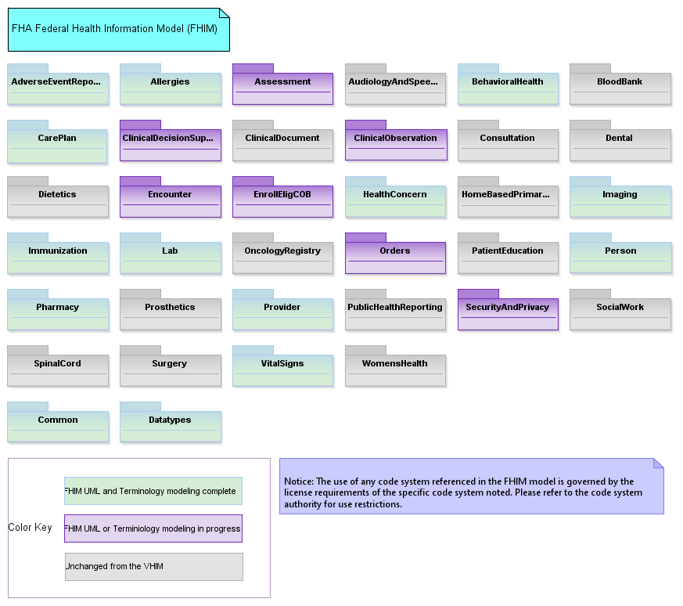
The FHIM Main Diagram

Slide 71
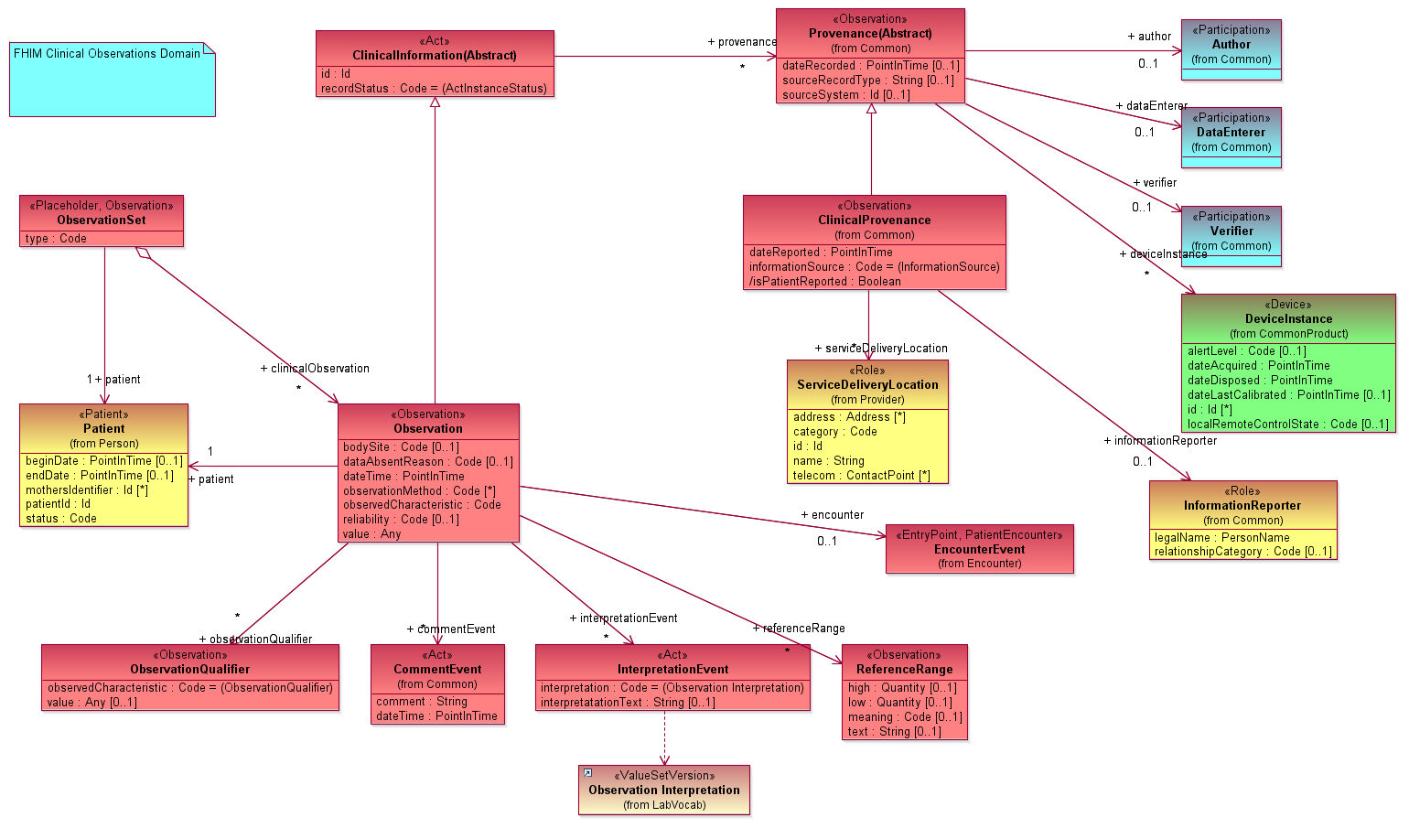
FHIM Clinical Observation

Slide 72
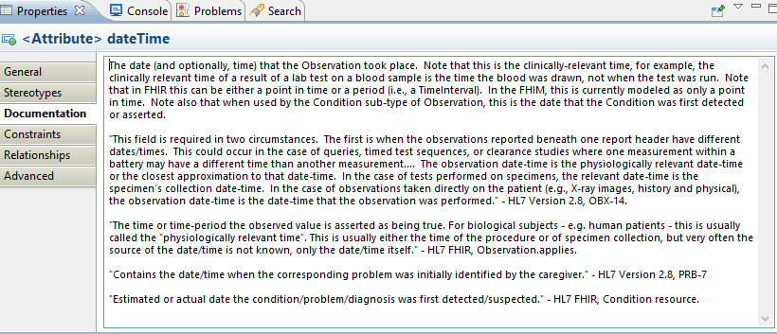
Documentation

Slide 73
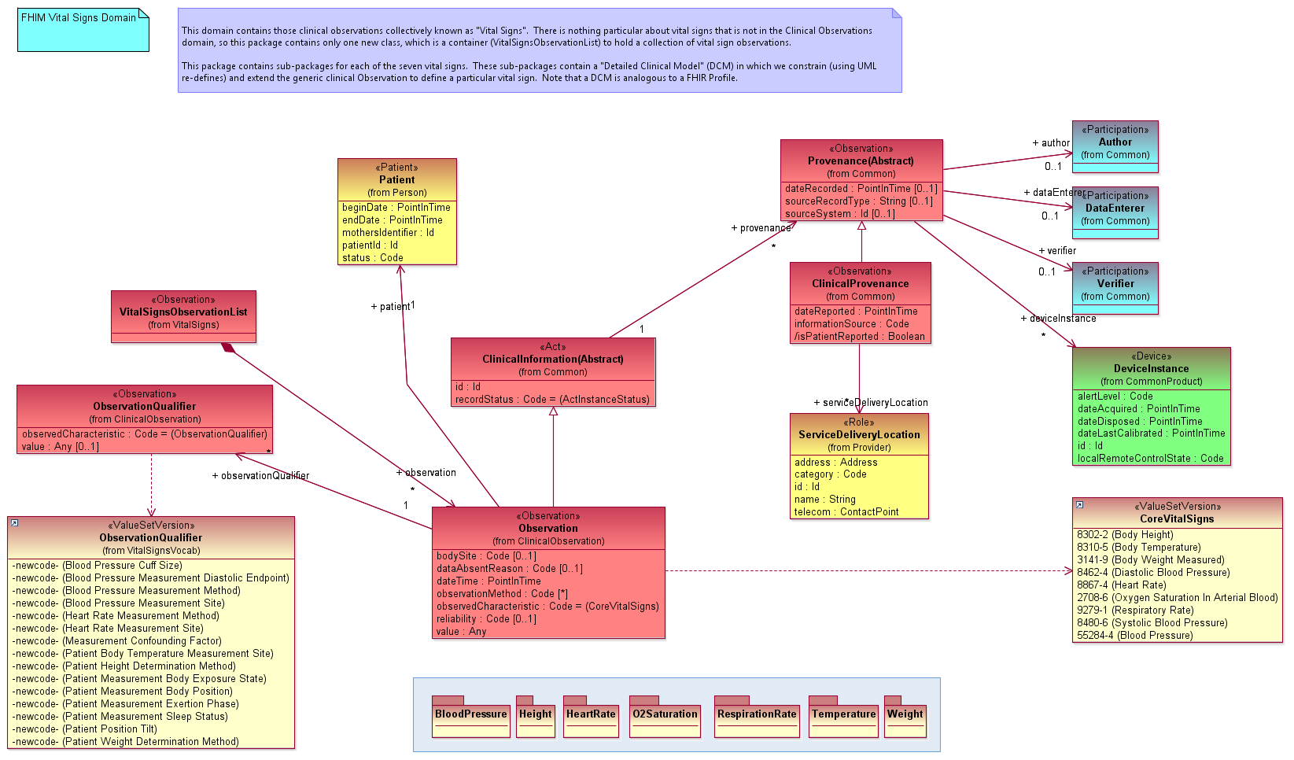
FHIM Vital Signs

Slide 74
FHIM “Detailed Clinical Models”
The FHIM primarily models generic structures like “Vital Signs”, which can accommodate any Vital Sign
Consistent with the approach of most standards
But we can create DCMs using UML “re-defines”
A re-define allows one to constrain a UML model by re-defining in a sub-type a property that was introduced in its super-type
The following slides show the Heart Rate DCM
Notes:
Please use the slide construction guidelines included on the next slide within your presentation.

Slide 75
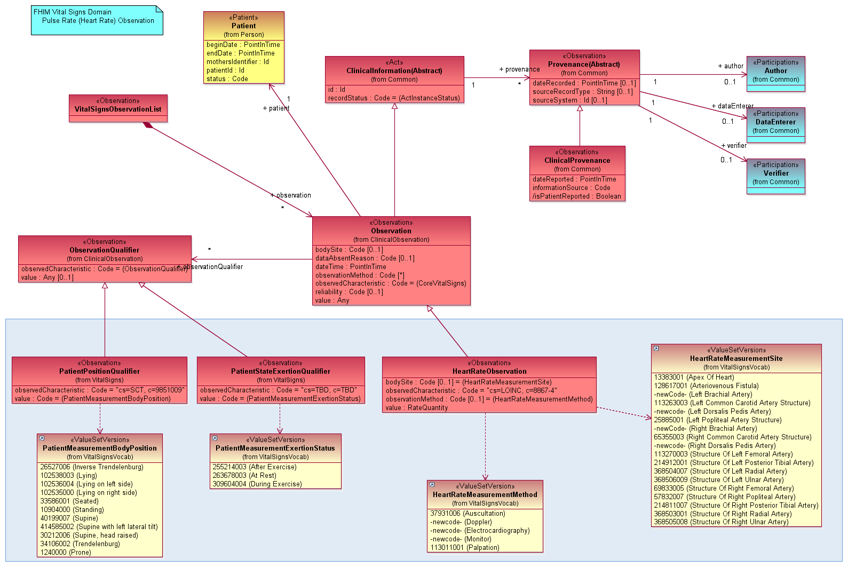
FHIM Vital Signs: Heart Rate

Slide 76
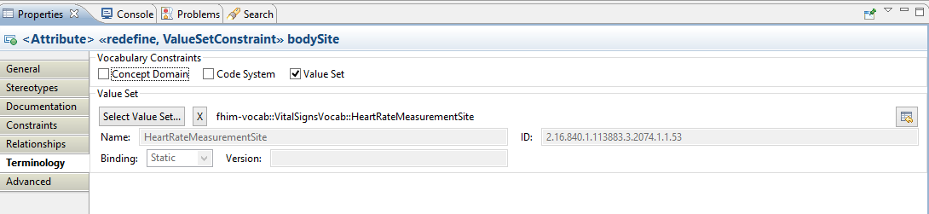
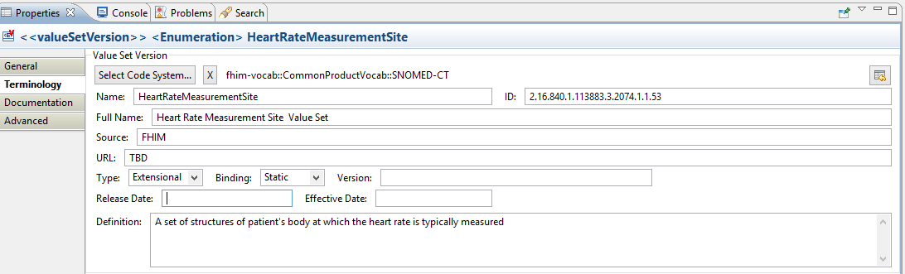
Terminology Binding in the FHIM
Once the value set is created VSAC, this will point to the page where it can be viewed

Slide 77
FHIM “Detailed Clinical Models” (cont)
We have demonstrated how DCMs can be modeled in the FHIM
But, while we “hand-built” the Vital Signs DCMs, we do not envision doing so for every DCM. We contend that the majority of DCMs should be generated from a knowledge base
Each DCM represents a set of possible values in the “code” and the “qualifiers” that could be related to post-coordinated concepts in a medical ontology (e.g., SOLOR)
Once generated into UML, the FHIM could then be used to generate implementable artifacts in multiple standard formats (e.g., FHIR, CDA, etc.)
Notes:
Please use the slide construction guidelines included on the next slide within your presentation.

Slide 78
Benefits of the FHIM
The FHIM provides the “missing logical model”
Can generate service payloads, both at the coarse and granular levels
FHIR JSON instance, or an HL7 v2 message
Test code for conformance of payloads
Notes:
Please use the slide construction guidelines included on the next slide within your presentation.
The FHIM provides the “missing logical model,” the absence of which hinders some standards individually, and the corpus of standards to which organizations must comply
In combination with MDHT, the FHIM can generate service payloads, both at the coarse grained level (e.g., Vital Signs) and at the fine grained level (e.g., Heart Rate)
Those payloads can be expressed in standard-compliant formats, e.g., a FHIR JSON instance, or an HL7 v2 message
Other code can be generated, including code to test conformance of the payloads

Slide 79
Harmonization of the Information Models
Nona Hall, ONC Liaison, IPO

Slide 80
We Need to Simplify
LOINC:
1L: Gentamicin is a component LOINC (GENTAMICIN)
2L: Gentamicin Is a component of a laboratory tests in LOINC(Gentamicin Peak)
RxNorm:
1R: Gentamicin is an ingredient in RxNorm (Gentamicin Sulfate)
2R: Gentamicin is a basis of strength in RxNorm (Gentamicin)
3R: Gentamicin is linked to Human Prescription Drug Labels
4R: Gentamicin is presented in prescribed/dispensable forms in RxNorm
5R: Gentamicin is a product in RxNorm
SNOMED:
1S: Gentamicin is a substance in SNOMEDO CT (a component in LOINC)
2S: Gentamicin is a component of a laboratory test SNOMED (Gentamicin Peak)
3S: Gentamicin is a product in SNOMED CT (a substance manufactured and sold)
4S: Gentamicin is an allergen in SNOMED CT
5S: Gentamicin is presented in prescribed/dispensable forms in SNOMED
6S: Gentamicin is specified in SNOMED administration and removal procedures
7S: Gentamicin is specified in poisoning/overdoes
8S: Gentamicin allergic reactions are defined clinical situations
9S: Acute drug –induced renal failure is a disorder in SNOMED

Slide 81
We Need to Simplify (cont)
Lab LOINC
2S; 2L
1L; 1S; 1R
RXNorm: 2R; 3R
3S; 5S; 4R; 5R
SNOMED: 4S; 5S; 6S; 7S; 8S; 9S

Slide 82
Opportunities Ahead
Today, implementation is too complicated, and not interoperable, even when using well known standards.
FHIM exists to address one form of information modeling for the federal partners
CIMI exists to address another form of information modeling for an even broader (international) community
There are even more that need to come together, and more importantly they need to become routinely and consistently used and more meaningful to implementers
The Opportunity: via the Jan 2016 HL7 CIMI Modeling Working Group Meeting, an Investigative Study has been initiated to entertain the integration of
FHIM
CIMI/HSPC
QUICK/CQF
SOLOR
Through applied tooling of the MDHT/MDMI
A Two-Day Technical Forum has been added to accent on the opportunity—to all stakeholders

Slide 83
Integration Opportunity
QUICK (CQF)
SOLOR
CIMI/HSPC
FHIM
Notes:
How can we use an integration of Shared Logical Model implementation of SNOMED + LOINC + RxNorm as a foundation for FHIM, CIMI, and FHIR so that we can simplify our implementations, yet attain significant interoperability?
Stay tuned...

Slide 84
Modeling Workshop – August 17 & 18
Topic: Information Modeling – Foundation to Semantic Interoperability
Cosponsored by:
DoD/VA Interagency Program Office
Federal Health Architecture
ONC Office of Standards & Technology
Approach: Leverage DoD/VA IPO’s Health Interoperability Exchange Alliance (HIEA) Technical Forum
Content: Created and orchestrated by the SMEs
Notes:
At Deloitte HQ in Rosslyn, VA

Slide 85
[initiative is TBD] approach
Gail Kalbfleisch, Director, FHA

Slide 86
Identity Management / Resource Locator
Develop and publish an architecture for:
Healthcare Directory Model
Patient Matching Model
Organization Model
Specialty Model
Insurance Model
Trust/Security Model

